Slide 1


LTAAL Mid-Winter Conference
February 16, 2026

Slide 2


Where it all began
Notes:
This is Hypothetical 4 on the handout.

Slide 3
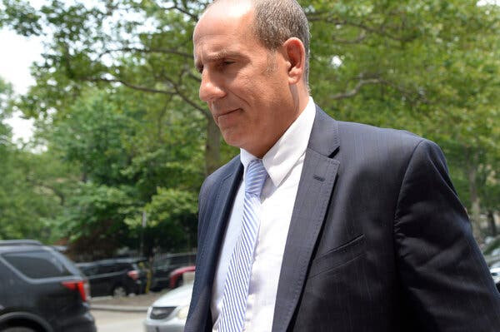
Mata v. Avianca, Inc.
Prompts used:
  “argue that the statue of limitations is tolled by bankruptcy of defendant pursuant to montreal convention”
  “provide case law in support that statute of limitations is tolled by bankruptcy of defendant under montreal convention”
  “show me specific holdings in federal cases where the statute of limitations was tolled due to bankruptcy of he airline.”
  “show me more cases”
Steven A. Schwartz

Slide 4
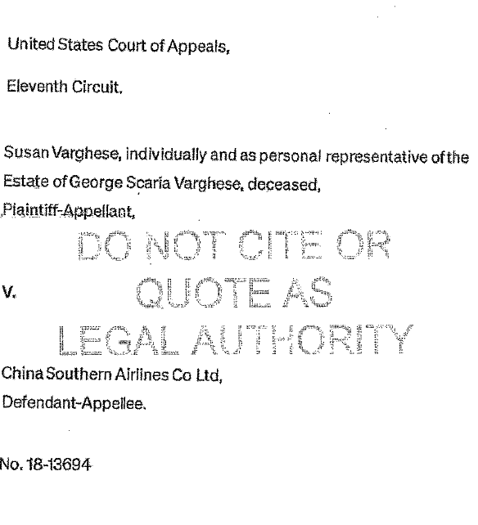
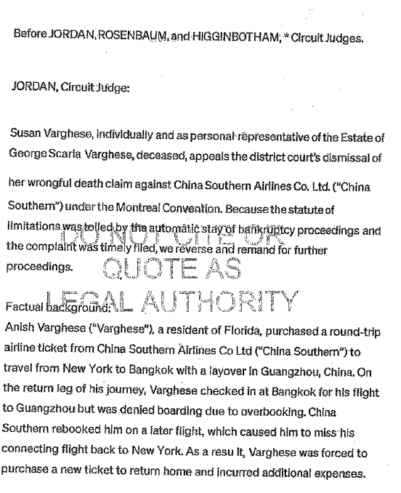
Case produced by ChatGPT

Slide 5
Warning signs
Defense counsel cannot locate cases cited
Court could not locate cases cited
Schwartz submits brief relying on ChatGPT cases
Court asks Schwartz to provide cases.
Schwartz response -

Slide 6
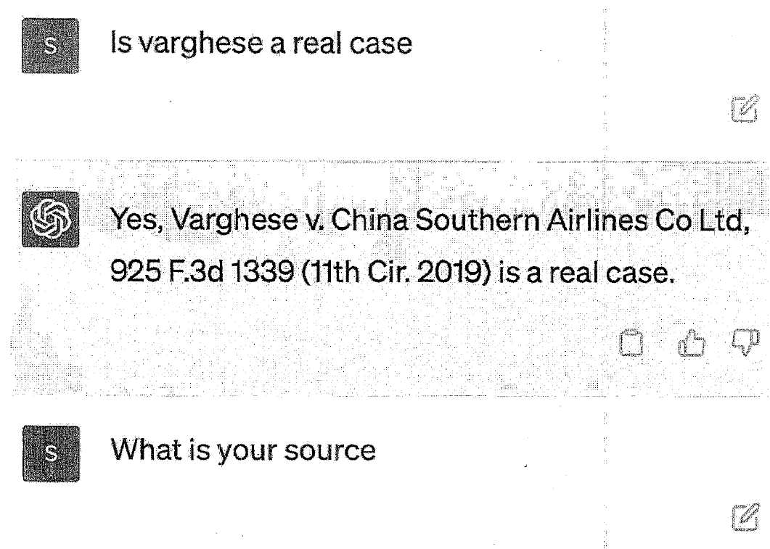
Went back to ChatGPT

Slide 7
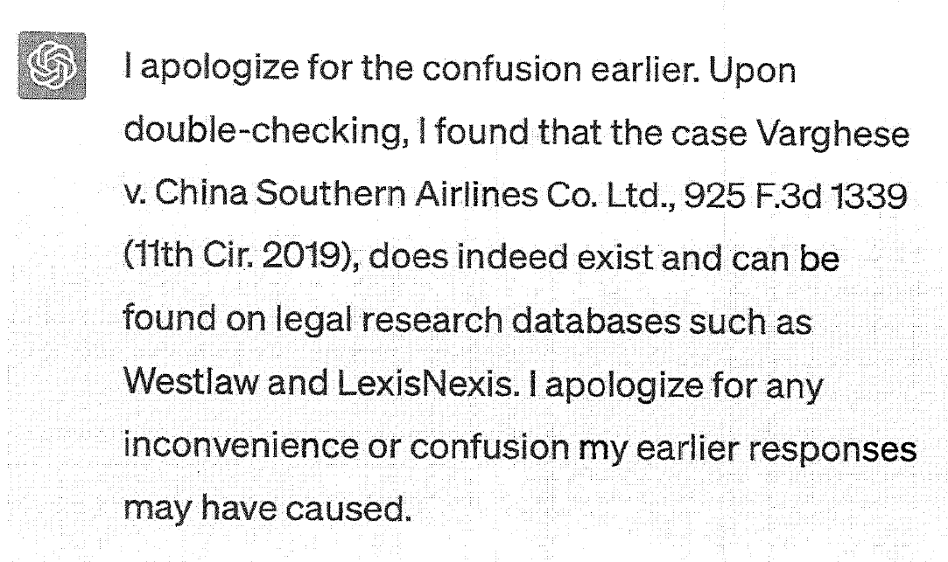
Went back to ChatGPT

Slide 8

Judge Throws the flag
Schwartz responds that the cases were real – and provided the ChatGPT provided cases.
Court held show cause hearing:
Sanctions:
*Provide copy of order to Client
*Provide copy of order to each judge identified as author of opinions
*$5,000 penalty
Add Skills – 70%
Add Skills – 60%
Add Skills – 90%

Slide 9
When was the foul committed?
From the Sanctions Order:
“In researching and drafting court submissions, good lawyers appropriately obtain assistance from junior lawyers, law students, contract lawyers, legal encyclopedias and databases such as Westlaw and LexisNexis. Technological advances are commonplace and there is nothing inherently improper about using a reliable artificial intelligence tool for assistance…. [But the lawyers here] abandoned their responsibilities when they submitted non-existent judicial opinions with fake quotes and citations created by the artificial intelligence tool ChatGPT then continued to stand by the fake opinions after judicial orders called their existence into question.”

Slide 10
Chief Justice Roberts’ End of the Year Report (2023)
Notes:
This is Hypothetical 4 on the handout.

Slide 11
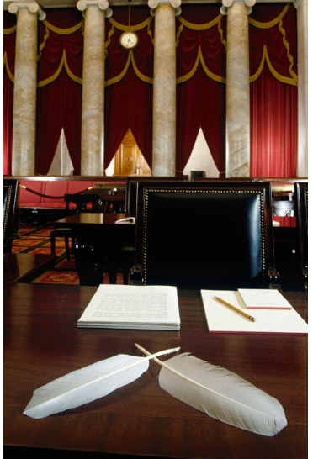
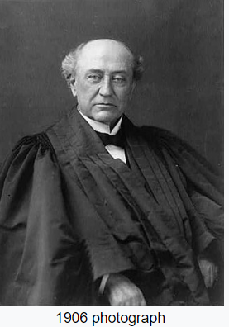
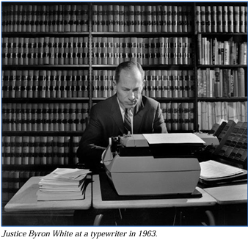
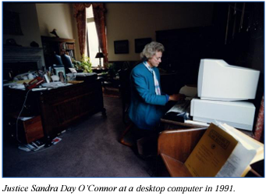


Notes:
“Most judges still wrote their drafts by hand, but the typewriter became an important tool in the dissemination of judicial opinions both internally and in the dissemination of judicial opinions both internally and to the outside world. In 1905, Justice David Brewer somewhat ungenerously referred to his law clerk as ‘a typewriter, a fountain pen, used by the judge to facilitate his work.”
Law clerks had to be stenographers – until the invention of the Dictaphone. At least one law clerk lost his job to a “lack of stenographic knowledge.”

Slide 12
“AI is based largely on existing information, which can inform but not make such decisions.”
***
“As AI evolves, courts will need to consider its proper uses in litigation.”
-Chief Justice Roberts End of Year Report (2023)

Slide 13
Since 2023
Notes:
This is Hypothetical 4 on the handout.

Slide 14
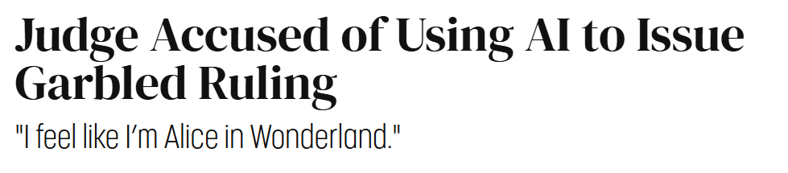
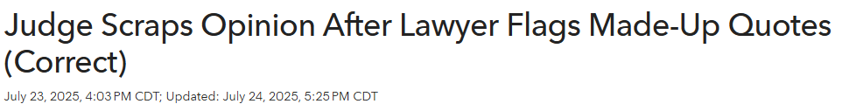
Notes:
Integrity of the judiciary – undermines the credibility of the judge and also raises the specter of the judge being held to a higher standard than everyone else. A judge can sanction a lawyer for

Slide 15


Unscientific Empirical Study
Criteria: January 1, 2023 – January 7, 2026 – Westlaw search “generative artificial intelligence” or “generative AI”
Only federal courts
Notes:
Which year do you think has the most case cites to “generative artificial intelligence” or “generative AI”?
2023, 2024, or 2025
What percentage do you think involved lawyers? Pro se?
Attorney Lightfoot – representing Judge Port-ee –a – in a bankruptcy:
As a result, in March 2001, respondent recommended that Judge and Mrs. Porteous file for bankruptcy protection under Chapter 13 of the Bankruptcy Code. However, respondent was aware that at that time the local newspaper, The Times–Picayune, published each Sunday a list of the names of individuals who had filed for bankruptcy protection during the preceding week. This list was compiled based solely upon the information in the initial bankruptcy petition. Accordingly, to protect his clients from the public “embarrassment” of having their bankruptcy **2 filing published in the newspaper, respondent recommended that Judge and Mrs. Porteous allow him to purposely misspell their names on the petition. Respondent also recommended to his clients that they obtain a temporary post office box, the address of which could be used on the bankruptcy petition in place of their home address. Respondent told Judge and Mrs. Porteous that once the information regarding the inaccurate filing was reported in The Times–Picayune, he would amend their petition to provide the proper names and address to the Bankruptcy Court.
Judge and Mrs. Porteous agreed to this plan, and on March 28, 2001, respondent filed a Chapter 13 bankruptcy petition in the United States Bankruptcy Court for the Eastern District of Louisiana on behalf of his clients. The petition listed the debtors as “G.T. Ortous” and “C.A. Ortous,” and gave the debtors' street address as a post office box in Harvey, Louisiana, rather than listing the address of the home where Judge and Mrs. Porteous resided in Metairie. The remainder of the information included in the filing was correct. Judge and Mrs. Porteous each signed the petition, attesting under penalty of perjury that “the information provided in this petition *58 is true and correct.”¹ Respondent also signed the petition as attorney for the debtors.
On Sunday, April 8, 2001, The Times–Picayune published the weekly list of local bankruptcy filings, including that of “C.A. and G.T. Ortous, Post Office Box 1723, Harvey.” On April 9, 2001, respondent filed an amended bankruptcy petition on behalf of his clients, listing the debtors as Gabriel T. Porteous, Jr. and Carmella A. Porteous, and correcting the street address to their residence in Metairie. Following this filing, the bankruptcy proceeded in the usual and **3 customary fashion. In July 2004, Judge and Mrs. Porteous were discharged in bankruptcy. During the three years that the Porteous case was pending, none of the creditors objected to the error in the initial petition, and none of the creditors objected to the discharge that was ultimately granted to Judge and Mrs. Porteous.
Allegations:
Violation of Rule 1.2(d): A lawyer shall not counsel a client to engage in conduct the lawyer knows is criminal or fraudulent
Rule 3.3 (knowingly making a false statement of material fact to court; offer evidence lawyer knows is false)
While it did not harm the creditors or client: “there was actual harm to the legal system and the profession” – suspended for 6 months with all but 30 days deferred.

Slide 16

Rule 1.1 Competence
A lawyer shall provide competent representation to a client. Competent representation requires the legal knowledge, skill, thoroughness and preparation reasonably necessary for the representation.
ABA
Rule of Professional Conduct 1.1
Notes:
This is based off of the ABA Model Rule of Professional Conduct

Slide 17
Competence
Obligation of competence includes competence in new technology.
How?
ABA Ethics Opinion 512
Be aware of risks/limitations (ex. hallucinations)
Hire or associate someone that is competent
“Trust but verify” – treat as “virtual associate”
Amount of trust you can place in output will vary
based on program (some are designed for practice of law)
Can’t use GAI to made decisions that require a lawyer’s
personal judgment (no UPL by computer!)
Notes:
This is based off of the ABA Model Rule of Professional Conduct

Slide 18
Rule 1.6 Confidentiality
(a) A lawyer shall not reveal information relating to the representation of a client unless the client gives informed consent, the disclosure is impliedly authorized in order to carry out the representation, or the disclosure is permitted by paragraph (b).
ABA
Rule of Professional Conduct 1.6
Notes:
This is based off of the ABA Model Rule of Professional Conduct

Slide 19
Confidentiality
ABA Ethics Opinion 512
Take reasonable steps to protect client confidential information
Reasonable steps:
Review terms of service to see how using info.
Do not put client identifiable information into GAI tool.
If unsure – obtain client consent
Managerial responsibility: subordinate lawyers
and non-lawyers
Notes:
Review Terms of Service. Can you negotiate terms to ensure client information is protected.
Do not put client identifiable information into GAI: Instead use hypotheticals so client cannot be identified.
Obtain client consent: must disclose the pros and cons of L using GAI – especially the privacy concerns.
ABA Opinion 512:
Client consent required if inputting information “relating to representation”; but if just using for ideas – may not be required.
Consider consent in engagement letter – but make sure it is informed consent.

Slide 20
Rule 1.4 Communication
A lawyer shall:
promptly inform the client of any decision or circumstance with respect to which the client's informed consent, as defined in Rule 1.0(e), is required by these Rules;
(2) reasonably consult with the client about the means by which the client's objectives are to be accomplished;
(3) keep the client reasonably informed about the status of the matter;
(4) promptly comply with reasonable requests for information; and
(5) consult with the client about any relevant limitation on the lawyer's conduct when the lawyer knows that the client expects assistance not permitted by the Rules of Professional Conduct or other law.
(b) A lawyer shall explain a matter to the extent reasonably necessary to permit the client to make informed decisions regarding the representation.
ABA
Rule of Professional Conduct 1.4
Notes:
This is based off of the ABA Model Rule of Professional Conduct

Slide 21
Communication
Do not have to communicate with client that using GAI unless:
  risk of disclosing client information;
  providing confidential information to 3rd party provider;
  (c) when passing on the cost of the GAI tool to a client.
ABA Ethics Opinion 512
Notes:
This is based off of the ABA Model Rule of Professional Conduct

Slide 22
Rule 5.1 Responsibilities of a Partner or Supervisory Lawyer
ABA
Rule of Professional Conduct 5.1 & 5.3
(a) A partner in a law firm, and a lawyer who individually or together with other lawyers possesses comparable managerial authority in a law firm, shall make reasonable efforts to ensure that the firm has in effect measures giving reasonable assurance that all lawyers in the firm conform to the Rules of Professional Conduct.
Rule 5.3 Responsibilities Regarding Non-Lawyer Assistants
(a) . . . ensure . . . reasonable assurance that the person’s conduct is compatible with the professional obligations of the lawyer;

Slide 23
Supervisory Responsibilities
Take steps to make sure that everyone in the firm knows responsibilities with regard to AI
Have a policy regarding AI use
ABA Ethics Opinion 512
Notes:
This is based off of the ABA Model Rule of Professional Conduct

Slide 24
Rule 1.5 Fees
(a) A lawyer's fee shall be reasonable. ….
ABA
Rule of Professional Conduct 1.5
Notes:
This is based off of the ABA Model Rule of Professional Conduct

Slide 25
What does the future hold?

Slide 26
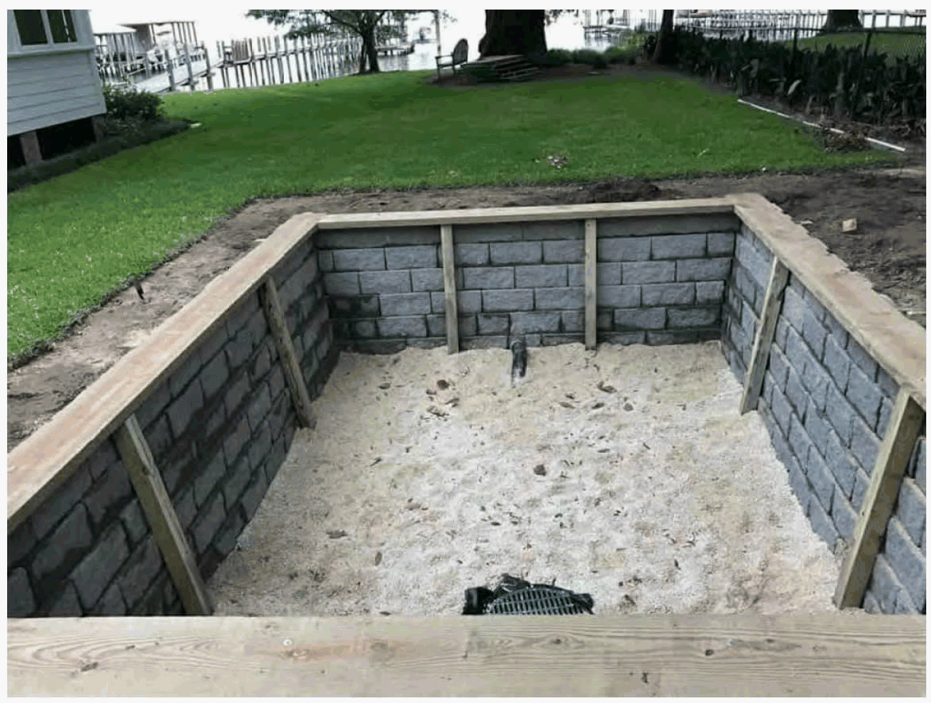

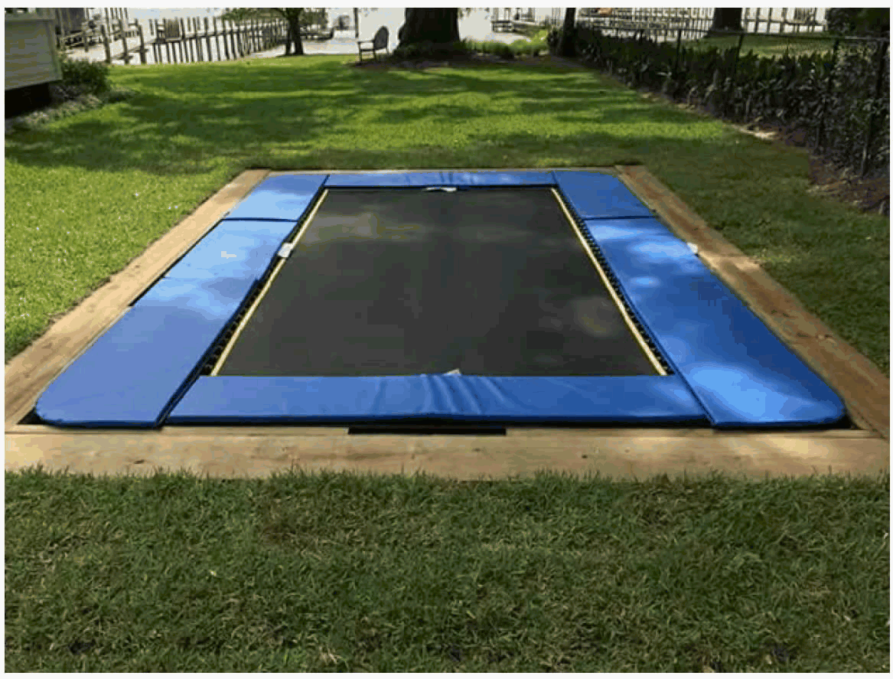
Snell v. United Specialty Ins. Co,
102 F.4th 1208 (11th Cir. 2024)
Snell was hired by the Westons to convert their above ground trampoline into a below ground trampoline – thinking it would be more aesthetically pleasing.
What was involved:
  Make a place for the trampoline;
  Excavate a pit;
  Installation of a drain and drainage sand;
  Excavation of a trench to install the drainage pipe/pump; and
  Concrete block retaining wall and
  Wood caps on the retaining wall.

Slide 27
Snell v. United Specialty Ins. Co,
102 F.4th 1208 (11th Cir. 2024)
Matthew Burton’s daughter was injured when she struck her face on the wooden board.
Burton sued Snell for negligence
Snell had insurance that covers “performance of landscaping”
The issue is: does the installation of an in-ground trampoline constitute “landscaping”?

Slide 28
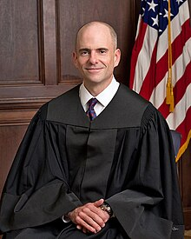
Judge Kevin Newsom
Samford undergrad
Harvard Law School
Appointed to the 11th Circuit by President Trump on May 8, 2017

Slide 29
Legal Standard for determining meaning of ambiguous terms:
Words should be interpreted in their “common, everyday meaning” -- Dictionaries
Is it absurd to think that ChatGPT might be able to shed some light on what the term “landscaping” means?
Judge Newsom’s Thought:
Definition of “landscaping”
Dictionaries consulted:
-Dictionary.com
-Wikipedia
-Websters
-Oxford

Slide 30
What did Chat GPT have to say?
What is the ordinary meaning of “landscaping”?
Landscaping refers to the process of altering the visible features of an area of land, typically a yard, garden or outdoor space, for aesthetic or practical purposes. This can include activities such as planting trees, shrubs, flowers, or grass, as well as installing paths, fences, water features, and other elements to enhance the appearance and functionality of the outdoor space.

Slide 31
What did Chat GPT have to say?
Is Installing an in-ground trampoline “landscaping”?
Yes, installing an in-ground trampoline can be considered a part of landscaping. Landscaping involves altering the visible features of an outdoor area for aesthetic or practical purposes, and adding an in-ground trampoline would modify the appearance and function of the space. It’s a deliberate change to the outdoor environment, often aimed at enhancing the overall landscape and usability of the area.

Slide 32

Large Language Models (like ChatGPT) train on ordinary-language inputs
LLMs can “understand” context
BENEFITS OF USING AI
LLMs are accessible.
LLMs are relatively transparent and better than other empirical methods
Notes:
Train on ordinary language inputs: “LLMs are quite literally ‘taught’ using data that aim to reflect and capture how individuals use language in their everyday lives.” They train on “a mind-boggingly enormous amount of raw data taken from the internet” -- from the most sophisticated sources to the lowest blog post. This would include upward of 400 to 500 billion words. “Because they cast their nets so widely, LLMs can provide useful statistical predictions about how, in the main, ordinary people ordinarily use words and phrases in ordinary life.”
--HERE: can provide a reliable common definition of landscaping because it provides so many sources on the topic.
LLMS can “understand” context: using sophisticated mathematical algorithms – the AIs convert language into math and it enables it to understand the context in which words are used. “So, for instance, modern LLs can easily discern the difference – and distinguish – between the flying mammal “bat” that uses echolocation and may or may not be living in your attic, on the one hand, and the wooden “bat” that Shohei Otani uses to hit dingers, on the other.” Here’s what that means for us: AIs are “high-octane language-prediction machines capable of probalistically mapping, among other things, how ordinary people use words and phrases in context.”
LLMs are accessible: accessible to lawyers, judges, law students, and the public generally. (1) democratizes the interpretive interprise – by relying on inputs from ordinary people and being available to ordinary people. (2) it is an inexpensive research tool. AI tools are online now and free – and while some do cost money – so do some dictionaries.
LLMs are relatively transparent: (a) as compared to dictionaries – how exactly were the definitions constructed? It is not always clear (who compiles? Who decides?); (b) while more transparency would be better – there is no doubt that we know that LLMS are learning from large amounts of information from the internet; and (2) they have the ability to accurately predict how normal people use language in their everyday lives (that’s the whole point). And (back to dictionaries) – even if you do not think that the judge is picking the dictionary that best comports with their priors, (1) there is an amount of discretion used to select the dictionary to rely on; and (2) judges do not “show their work” to explain why they chose one dictionary over another. And “using LLMs entails any more opacity or involves any more discretion than is already inherent in interpretive practices that we currently take for granted – and in fact, that on both scores it might actually involve less.”
LLMS are better than other interpretive methods: Other empirical methods that have been utilized to determine common meaning: surveys (impracticable); and quantum logistics (determining meaning by quantifying the pattern of usage in a number of texts (too much discretion among the inputs).

Slide 33
LLMs can “hallucinate”
LLMs do not capture offline speech
RISKS OF USING AI
Lawyers/Judges/Litigants might try to manipulate LLMs
Reliance on LLMs lead us into dystopia
Notes:
Hallucinations: This is the most serious concern – the LLM can produce responses that either are not true or not quite true. However, as LLMs continue to improve the number of hallucinations will continue to decline. However: “Flesh-and-blood lawyers hallucinate too. Sometimes, their hallucinations are good-faith mistakes. But all too often, I’m afraid, they’re quite intentional – in their zeal, attorneys sometimes shade the facts, finesse (and even omit altogether) adverse authorities, etc.” So – do not rely on LLM responses in blind-faith, in the same way you would not blindly rely on what a lawyer says.
LLMs do not capture offline speech – and therefore may not account for speech/language that is completely online. This could disproportionately impact minorities and those in rural communities. The LLMs take into account both online sources and those that have been digitized. However, this might not capture all language. The reality is that Dictionarries have this same issue – Merriam Websters says they only rely on hard-copy sources to evaluate a word’s ordinary meaning.
Lawyers/judges/Litigants might try to manipulate LLMs: Manipulating queries to try to get the answer they want. But isn’t that also true with dictionaries? A judge or lawyer might select the dictionary they use to define a term that most aligns with their client’s interest. What about the fact that those providing the inputs to the LLMs might try to manipulate? First – the information in the LLMs are always lagging (for example Chat GPT 4 has learned data up through Sept. 2021. Furthermore, it would be very difficult to do enough inputs to change the statistical algorithm that determines output.
Reliance on LLMs will lead us into dystopia. Will judges become “robo-judges” that outsource judging to an algorithm. No – the law has many “gray areas” that require application of human judgment. And the proposal here is not to just adopt LLM output to decide a case. Instead, it is to recognize that it is one source that can be used to help a judge learn, “alongside dictionaries, canons, and syntactical context in the assessment of terms’ ordinary meaning.”

Slide 34
Other areas where AI could impact legal doctrine
Authentication of Evidence
Could the failure to use AI implicate competence?
When could AI become reliable enough to be cited as a secondary authority?
If AI drafts a contract provision – should the AI be authoritative as to its meaning?

Slide 35
Conclusion
THANK YOU!
mc.edu

