Slide 1
Cyber Fraud
Alan Ottarson
Technical Special Agent
Nashville Field Office

Slide 2
The best way to deal with a cybersecurity incident…

Slide 3
The best way to deal with a cybersecurity incident…
Is to prevent it before it happens!

Slide 4
The best way to deal with a cybersecurity incident…
Is to prevent it before it happens!
Basic cyber hygiene
  Robust password policies
  MFA
  VPN for remote work

Slide 5
The best way to deal with a cybersecurity incident…
Is to prevent it before it happens!
Basic cyber hygiene
  Robust password policies
  MFA
  VPN for remote work
  NO SHARED-ACCESS INBOXES

Slide 6
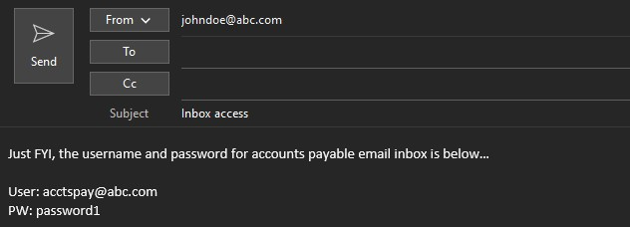
The best way to deal with a cybersecurity incident…
Is to prevent it before it happens!
Basic cyber hygiene
  Robust password policies
  MFA
  VPN for remote work
  NO SHARED-ACCESS INBOXES

Slide 7
The best way to deal with a cybersecurity incident…
Is to prevent it before it happens!
Basic cyber hygiene
  Robust password policies
  MFA
  VPN for remote work
  NO SHARED-ACCESS INBOXES

Slide 8
Business Email Compromise (BEC) schemes
Sophisticated scam targeting both businesses and individuals who are transferring funds
Fraudsters and the scheme continue to evolve
The fraudulent wire transfers are often immediately transferred and quickly dispersed, making recovery efforts difficult
In 2024, the IC3 received 21,442 Business Email Compromise (BEC)/Email Account Compromise (EAC) complaints with adjusted losses over $2.7 billion.
Current #1 targeted industry?
Notes:
Bad actors located worldwide
Domestic subjects using servers located in other countries to further fraud
Large organized groups in West Africa, East Europe, Central/South America, Asia
Two criminal components
Wire fraud
Money laundering/bank fraud

Slide 9
Business Email Compromise (BEC) schemes
Sophisticated scam targeting both businesses and individuals who are transferring funds
Fraudsters and the scheme continue to evolve
The fraudulent wire transfers are often immediately transferred and quickly dispersed, making recovery efforts difficult
In 2024, the IC3 received 21,442 Business Email Compromise (BEC)/Email Account Compromise (EAC) complaints with adjusted losses over $2.7 billion.
Current #1 targeted industry? Real estate!
Notes:
Bad actors located worldwide
Domestic subjects using servers located in other countries to further fraud
Large organized groups in West Africa, East Europe, Central/South America, Asia
Two criminal components
Wire fraud
Money laundering/bank fraud

Slide 10
Ransomware schemes
Involve network intrusion (similar to BEC), but generally require a higher level of access or more active targeting.
Data is encrypted and exfiltrated to bad actor’s system and held for ransom
Notes:
Bad actors located worldwide
Domestic subjects using servers located in other countries to further fraud
Large organized groups in West Africa, East Europe, Central/South America, Asia

Slide 11
Ransomware schemes
Involve network intrusion (similar to BEC), but generally require a higher level of access or more active targeting.
Data is encrypted and exfiltrated to bad actor’s system and held for ransom
In 2024, approximately 3,156 complaints related to ransomware with an adjusted loss of more than $12 million.
Ransomware is a problem and most certainly a threat to be taken seriously, but entities are MUCH more likely to fall victim to email compromises.
#1 target of ransomware is healthcare institutions
Notes:
Bad actors located worldwide
Domestic subjects using servers located in other countries to further fraud
Large organized groups in West Africa, East Europe, Central/South America, Asia

Slide 12
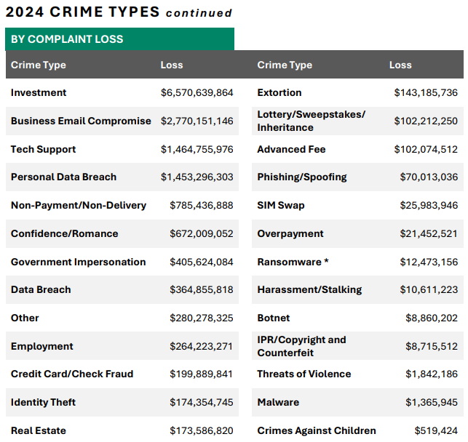
Why are these schemes so prevalent?

Slide 13
Why are these schemes so prevalent?
Over $15 billion in total loss!

Slide 14
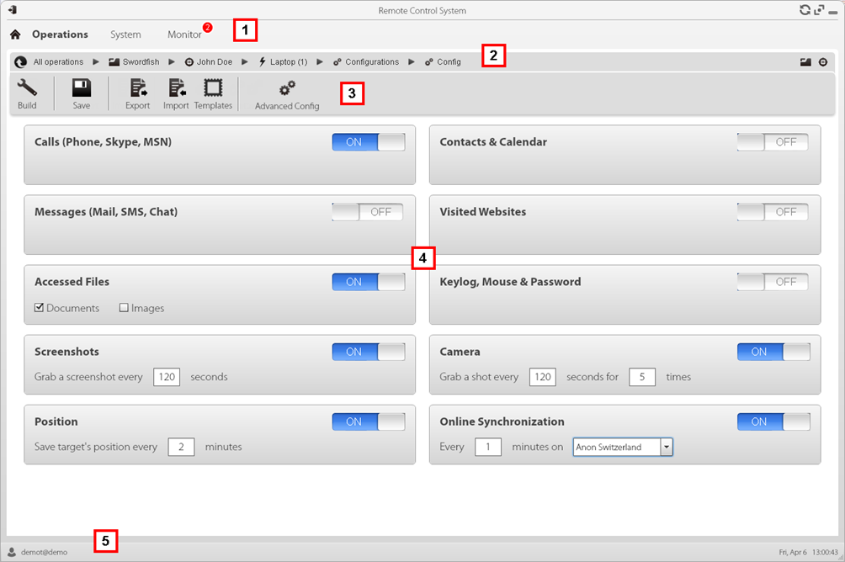
Hacking/malware as a service
Allows traditional organized crime to branch out
Single bad actors without technical knowledge can compromise

Slide 15
How do BECs begin?
Can be targeted attacks
Notes:
- Can also use stolen credentials purchased on dark web

Slide 16
How do BECs begin?
Can be targeted attacks
Frequently are a numbers game
  Shotgun approach through phishing email campaigns
Notes:
- Can also use stolen credentials purchased on dark web

Slide 17
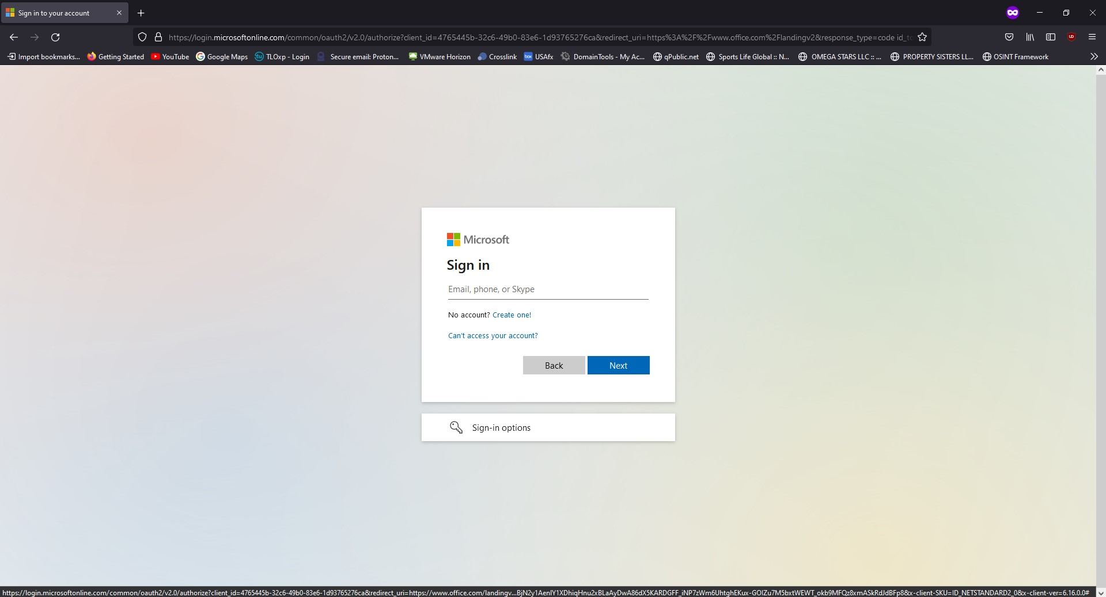
How do BECs begin?
Can be targeted attacks
Frequently are a numbers game
  Shotgun approach through phishing email campaigns
Notes:
- Can also use stolen credentials purchased on dark web

Slide 18
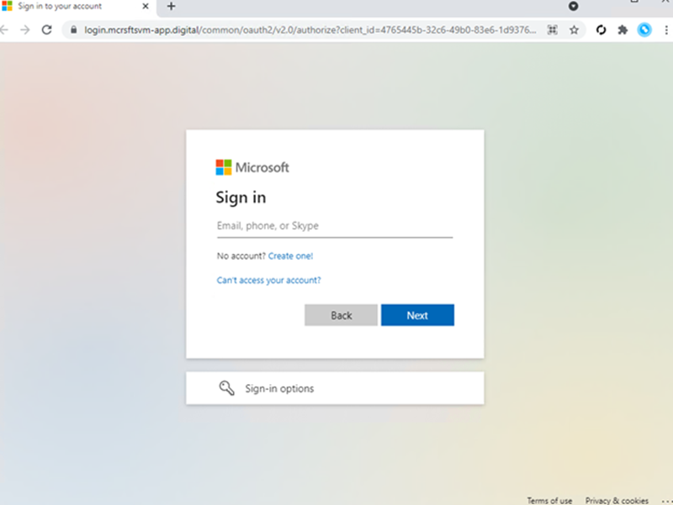
How do BECs begin?
Can be targeted attacks
Frequently are a numbers game
  Shotgun approach through phishing email campaigns
Notes:
Can also use stolen credentials purchased on dark web
MitM attacks to steal session cookies and allow bypass of MFA

Slide 19
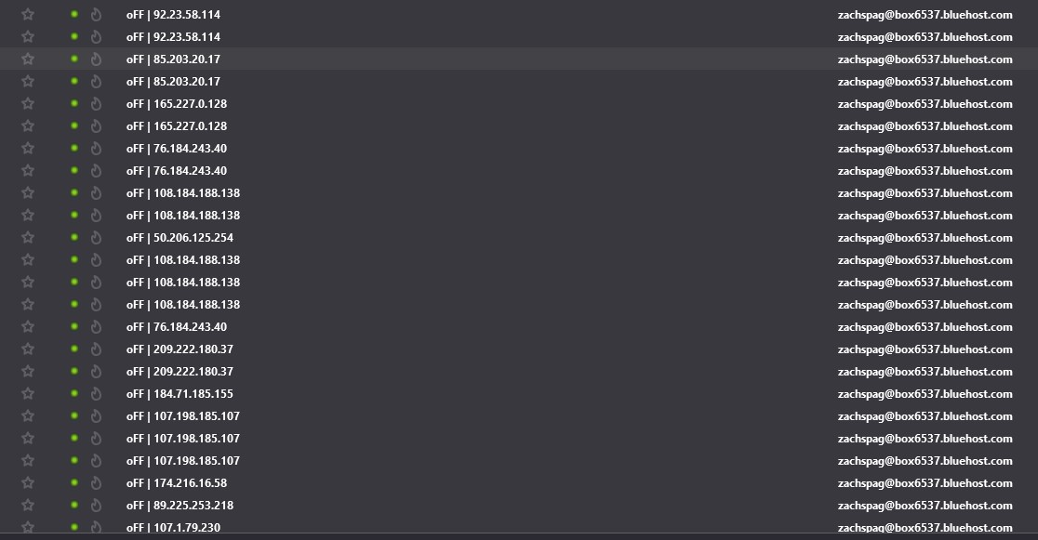
How do BECs begin?
Can be targeted attacks
Frequently are a numbers game
  Shotgun approach through phishing email campaigns
Notes:
Can also use stolen credentials purchased on dark web
MitM attacks to steal session cookies and allow bypass of MFA

Slide 20
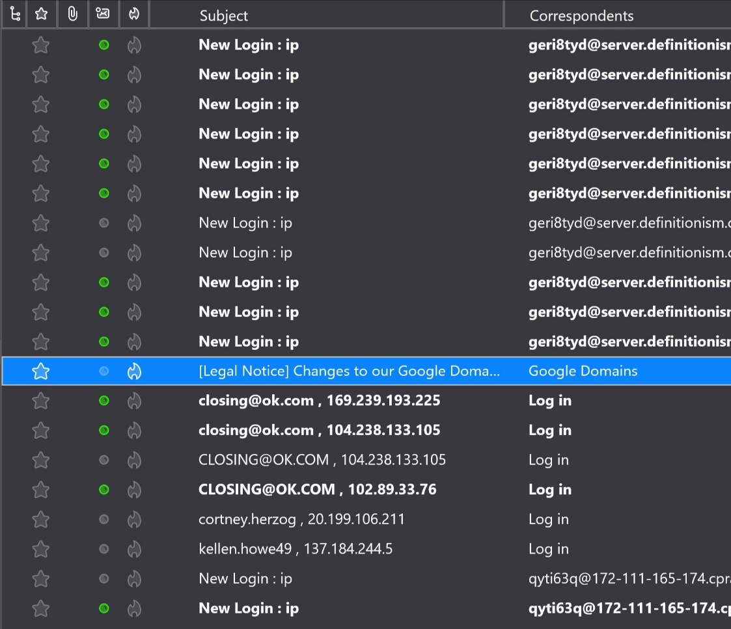
How do BECs begin?
Can be targeted attacks
Frequently are a numbers game
  Shotgun approach through phishing email campaigns
Notes:
Can also use stolen credentials purchased on dark web
MitM attacks to steal session cookies and allow bypass of MFA

Slide 21
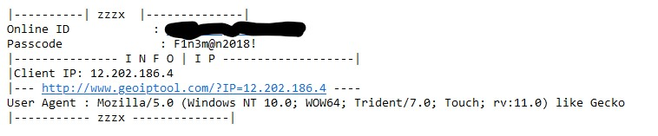
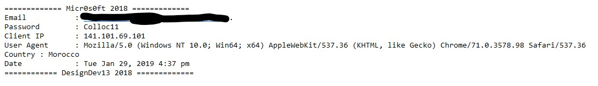
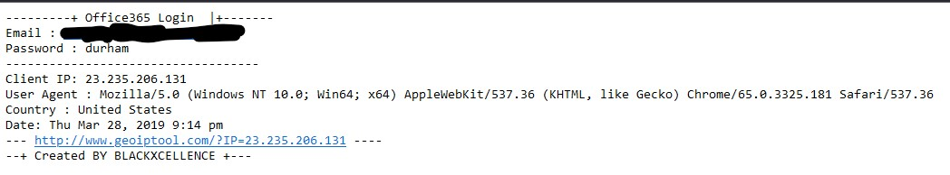
How do BECs begin?
Can be targeted attacks
Frequently are a numbers game
  Shotgun approach through phishing email campaigns
Notes:
Can also use stolen credentials purchased on dark web
MitM attacks to steal session cookies and allow bypass of MFA

Slide 22





BEC Standard Operating Procedure
Step 1: Regular Email
Correspondence
Employees use email correspondence to perform regular business duties, which can include making payments to vendors, processing payroll, or various other financial matters
Step 2: Interception
Hackers can intercept the email communication, and see who is the intended recipient
Step 3: Spoofed Email
Created
Hackers then create rules and potentially a spoofed email address, emulating the client
Hackers send an email either from the legitimate account or a spoofed email address as the client, requesting a transfer of funds – often to newly created bank accounts
Step 4: Send Spoof Email
with Instructions
Step 5: Funds sent
to Fraudsters
The instructions appear to be legitimate, and so the business transfers the funds to a fraudster’s account

Slide 23
BEC Standard Operating Procedure
Step 1: Regular Email
Correspondence
Employees use email correspondence to perform regular business duties, which can include making payments to vendors, processing payroll, or various other financial matters
Step 2: Interception
Hackers can intercept the email communication, and see who is the intended recipient
M. KAREN_RIHA@NewYorkLlfe.com
KAREN_RIHA@NewYorkLife.com
Step 3: Spoofed Email
Created
Hackers then create rules and potentially a spoofed email address, emulating the client
Hackers send an email either from the legitimate account or a spoofed email address as the client, requesting a transfer of funds – often to newly created bank accounts
Step 4: Send Spoof Email
with Instructions
Step 5: Funds sent
to Fraudsters
The instructions appear to be legitimate, and so the business transfers the funds to a fraudster’s account

Slide 24
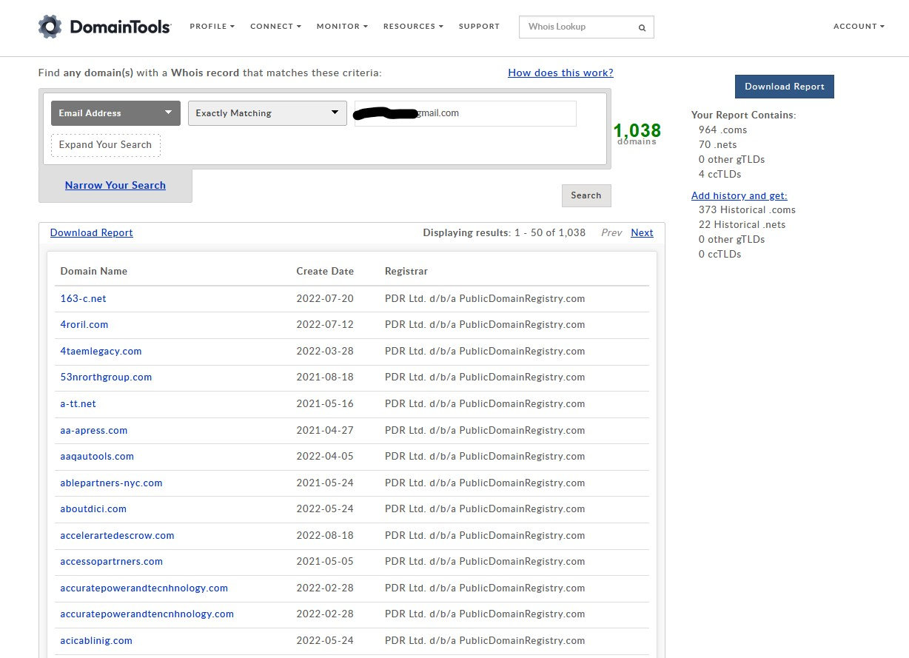
BEC Standard Operating Procedure
Step 1: Regular Email
Correspondence
Employees use email correspondence to perform regular business duties, which can include making payments to vendors, processing payroll, or various other financial matters
Step 2: Interception
Hackers can intercept the email communication, and see who is the intended recipient
Step 3: Spoofed Email
Created
Hackers then create rules and potentially a spoofed email address, emulating the client
Hackers send an email either from the legitimate account or a spoofed email address as the client, requesting a transfer of funds – often to newly created bank accounts
Step 4: Send Spoof Email
with Instructions
Step 5: Funds sent
to Fraudsters
The instructions appear to be legitimate, and so the business transfers the funds to a fraudster’s account

Slide 25
BEC Standard Operating Procedure
Step 1: Regular Email
Correspondence
Employees use email correspondence to perform regular business duties, which can include making payments to vendors, processing payroll, or various other financial matters
Step 2: Interception
Hackers can intercept the email communication, and see who is the intended recipient
Step 3: Spoofed Email
Created
Hackers then create rules and potentially a spoofed email address, emulating the client
Hackers send an email either from the legitimate account or a spoofed email address as the client, requesting a transfer of funds – often to newly created bank accounts
Step 4: Send Spoof Email
with Instructions
Step 5: Funds sent
to Fraudsters
The instructions appear to be legitimate, and so the business transfers the funds to a fraudster’s account

Slide 26
Operational Tactic – Email Rules
Once the criminal actors gain access to email accounts, the most common form of surveillance is to set up email rules in the account settings to auto-forward, then delete the auto-forwarded emails to avoid detection.
Other than the email rule, no evidence of the surveillance is visible. This allows the actor to remotely monitor the account even if the password is changed.
If the password or access method remains the same, the criminal actor can manipulate the victim's inbox to prevent detection or to further facilitate the fraudulent transactions.

Slide 27
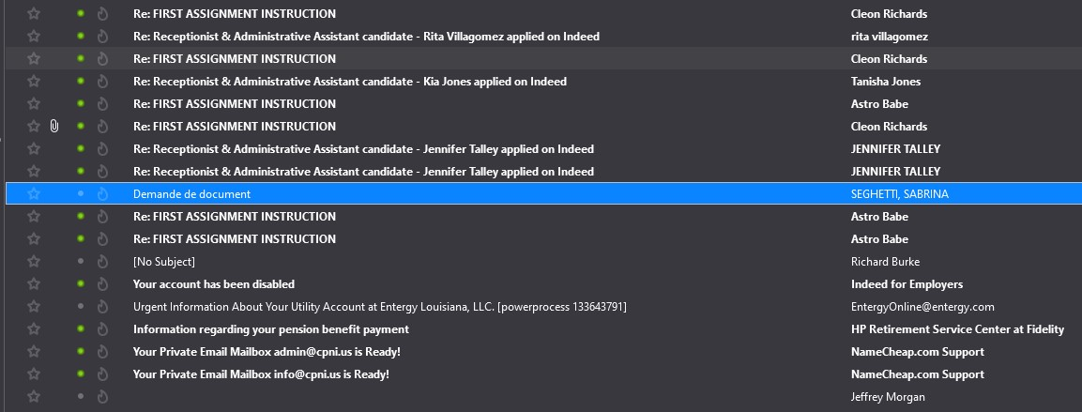

Slide 28
Operational Tactic – Email Rules
Once the criminal actors gain access to email accounts, the most common form of surveillance is to set up email rules in the account settings to auto-forward, then delete the auto-forwarded emails to avoid detection.
Other than the email rule, no evidence of the surveillance is visible. This allows the actor to remotely monitor the account even if the password is changed.
If the password or access method remains the same, the criminal actor can manipulate the victim's inbox to prevent detection or to further facilitate the fraudulent transactions.

Slide 29
General Recommendations
Multi-factor authentication for web applications/email
Trusted devices
Trusted IP addresses
  Geofence to local region
  Block known anonymizer IPs
  Block certain ISPs
Ensure that logs are being retained for at least 30 days
  Often bad actors can be monitoring accounts for months prior to the attack so the longer the data is preserved the better
Verbally verify any payment changes using a previously known/verified phone number
Training
Purchase/maintain similar domain names

Slide 30
Guidance for BEC Victims
Contact the originating financial institution as soon as fraud is recognized to request a recall or reversal and a Hold Harmless Letter or Letter of Indemnity.
Contact law enforcement and file a complaint with www.ic3.gov
  https://www.secretservice.gov/contact/field-offices
Preserve emails in their original format and have IT review system and save related logs.
  Third-party IT services can be very useful in remediation

Slide 31

GIOC BEC Desk
Central intake
Coordination of major cases
Rapid response

Slide 32
GIOC BEC Desk
Central intake
Coordination of major cases
Rapid response
  Working as a domestic analogue to FinCEN for domestic transfers
  Since inception in 2019, we’ve assisted in the recovery of approx. $250 million
  Referrals from field offices, local/state LE, private sector, victims

Slide 33
What will LE do?
Recovery of stolen funds
Forensic response to identify indicators of compromise (IoC)
Identification and prosecution of bad actor
  Restitution granted by court system in the event we are unable to initially recover loss

Slide 34


What will LE do?
Recovery of stolen funds
Forensic response to identify indicators of compromise (IoC)
Identification and prosecution of bad actor
  Restitution granted by court system in the event we are unable to initially recover loss
RECOVERY OF STOLEN FUNDS

Slide 35
What will LE NOT do?
Talk publicly about the investigation
Seize compromised systems
Look for evidence of other crimes in compromised systems
Attempt to “go after” victim

Slide 36
BECDesk.GIOC@usss.dhs.gov
Alan Ottarson, Technical Special Agent
Nashville Field Office
alan.ottarson@usss.dhs.gov

