Slide 1
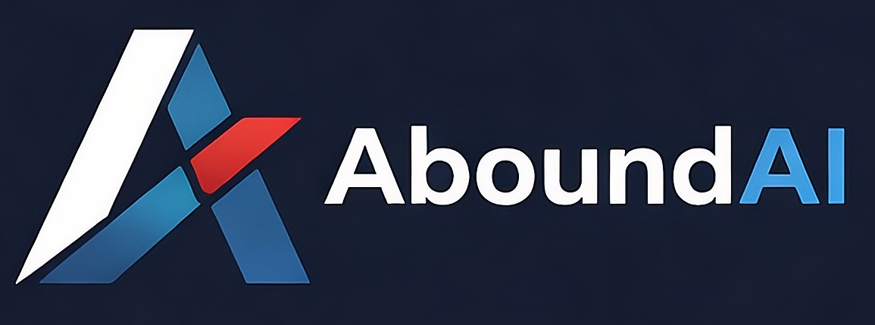
Practical AI in the Title Industry
How it works, where it fits, and two workflows running in production today
Patrick Curry | Founder, AboundAI | Co-Owner, Allegiance Title Company
August 2026
Notes:
Introduce yourself: co-owner of Allegiance Title in Northwest Arkansas and founder of AboundAI, which builds AI powered data services for the title and closing industry. Set expectations for the 30 minutes: this is not a talk about AI hype or theory. First we will spend about 12 minutes on how these tools actually work, what the model choices are, and how they are priced. Then we will spend the rest of the time on two real workflows my companies run in production today: automated commitment hyperlinking and a plain English agent that answers questions against our title plant. Everything shown is a real screenshot from a live system, not a mockup.

Slide 2



The next 30 minutes
1. How AI actually works
2. Where AI fits
3. Two production workflows
Probabilistic systems, model choices, and what a token costs
A simple framework for picking the right tasks and staying out of trouble
Commitment hyperlinking and a title plant you can talk to
Goal: leave with a working mental model and at least one workflow you could start next month.
Notes:
Walk through the three parts quickly. Emphasize the goal statement at the bottom: the audience should leave with a mental model for evaluating AI tools, plus at least one concrete workflow idea they could pilot in their own shop. Mention that questions are welcome at the end and you are happy to talk specifics afterward.

Slide 3



How AI actually works
A large language model predicts the most likely output based on patterns it learned from enormous amounts of text. It is not looking up answers in a database.
It reads like a fast, tireless junior employee
Give it a document and it can summarize, extract, classify, and compare with strong accuracy.
The mental shift
Stop asking "is AI smart?"
Start asking "is this task a good fit?"
Its strengths are language and documents
Commitments, deeds, mortgages, emails, legal descriptions. Text in, structured answers out.
It can be confidently wrong
The same tool that drafts a flawless summary can also invent a book and page number. The difference is the task, not the tool.
When it lacks information it may fill the gap with something plausible. Design your workflow assuming this.
Notes:
Keep this non technical. The key concept: a language model is a prediction engine, not a lookup table. That is why it is excellent at reading and producing language, and also why it can state a wrong answer with full confidence. Use a title specific example: ask it to summarize a commitment and it will do a great job; ask it for a book and page number it never saw and it may invent one that looks real. The takeaway on the right is the framing for the whole talk: fit the task to the tool.

Slide 4


Not all models are the same
Two questions decide which one belongs on a job: who controls it, and how much capability the task actually needs.
Frontier models
Open weight models
Run by the large labs and reached through their service
Best accuracy on hard reading and reasoning
Your documents go to their servers, so the contract matters
Priced per use, nothing to install or maintain
Published weights you can download and run yourself
Documents never leave hardware you control
Close to frontier quality on routine work, behind on the hardest
You own the servers, the updates, and the security
Every family has a tier ladder. A small fast model classifies a document. A large one handles judgment. Matching the tier to the task is most of the cost control.
Notes:
Keep this vendor neutral and practical. Frontier models are the big commercial systems you reach through a service: the strongest accuracy on hard reading, priced per use, nothing to install. The tradeoff is that your documents travel to someone else's servers, which makes the vendor agreement a real diligence item for a title agency handling nonpublic personal information. Open weight models publish their parameters so you can download and run them on hardware you control, and the documents never leave your building. Through 2026 the quality gap on routine work narrowed sharply while the price gap stayed wide, which is why open models now carry a large share of production volume at a small fraction of total spend. The catch is that you inherit the infrastructure, the updates, and the security. Land on the bottom bar: within any family there is a ladder from small and cheap to large and capable, and we deliberately use a small model to classify a document and a larger one for judgment calls. Refresh specific model names and prices the week of the talk, since both move monthly.

Slide 5


Tokens are the unit of cost
Models read and write in tokens, not words. A token is roughly three quarters of a word, and you are billed for everything that goes in and everything that comes back.
750
20k
cents
words in about 1,000 tokens
tokens in a typical commitment
to have a model read one
The context window
What drives your bill
How much the model can hold at once. Large windows let you drop in a whole file, but every token in there is billed, and accuracy drops when it is packed with material the question never needed.
Pages processed, not seats. A chat subscription is a flat monthly cost. Automation is metered per document, so spend tracks your file count and you can forecast it per closing.
This is why the agent retrieves the right documents first instead of handing the model the entire plant.
Notes:
Demystify the pricing model, because this is the first question people ask once they believe it works. A token is a chunk of text, roughly three quarters of a word, and both the document you send and the answer you get back are counted. Use the middle number to make it concrete: a typical commitment package runs around twenty thousand tokens, and having a capable model read the whole thing costs cents, not dollars. Context window is the second concept: how much the model can hold at one time. Bigger is not automatically better, because you pay for everything you put in the window and accuracy degrades when it is stuffed with irrelevant material. The right side is the business framing: automation is metered per document rather than per seat, so you can forecast cost per file the same way you forecast a recording fee. Close with the bridge line, which sets up the plant agent later: the reason it searches first and reads second is both cost and accuracy.

Slide 6


Deterministic vs. probabilistic
Deterministic
Probabilistic
Same input, same output, every time
Best judgment with a confidence level
Prorations and payoff math
Recording fees and transfer tax
Net sheets and settlement statements
Anything with a formula or a rule
Reading a scanned 1946 deed
Classifying a document by type
Matching references to recorded documents
Summarizing or drafting language
Keep this in software and formulas. AI should call the calculator, not be the calculator.
This is where AI earns its keep. Pair it with review and confidence thresholds.
Rule of thumb: money and math stay deterministic. Language and documents are the AI opportunity.
Notes:
This is the most important concept slide. Deterministic work has one right answer that a formula produces: prorations, fees, payoffs. Do not hand that to a probabilistic system; your existing software already does it perfectly. Probabilistic work is judgment under uncertainty: reading a rough scan, deciding whether a document is a mortgage or a deed of trust, matching a reference in a commitment to a recorded instrument. Humans do this work probabilistically too, which is exactly why AI can help there. Land on the rule of thumb at the bottom and pause on it.

Slide 7




Picking the right task
Four filters we apply before automating anything
High repetition, low variability
Clearly defined inputs and outputs
The task looks nearly the same on every file. Volume is where automation pays.
You can describe exactly what goes in and what a correct result looks like.
Low blast radius if it fails
A human stays in the loop
A miss is caught internally and costs minutes, not a claim or a customer.
Review the output, especially early. Trust is earned per workflow.
The goal is to remove mechanical work, not judgment.
Notes:
These four filters came out of real experience, not theory. Repetition: if a task happens on every file, small time savings compound fast. Defined inputs and outputs: if you cannot describe what correct looks like, you cannot verify the AI either. Blast radius: start with tasks where a failure is an internal inconvenience, never a customer facing error. Human in the loop: every workflow we run started with 100 percent review, and review only relaxes as accuracy proves out. Close with the line at the bottom, which is the philosophy behind both examples coming next: remove mechanical work, not judgment.

Slide 8



Getting good results
The habits that separate useful output from noise
Be specific and give context
Treat it like a new hire on day one. Include the document, the county quirks, and what a good answer looks like.
Where to start today
Summarize a long commitment before an exam
Draft a first pass of a client email
Extract parties and legals from a scanned deed
Compare two versions of a contract
Show examples of correct output
One or two worked examples improve accuracy more than a page of instructions.
Verify before it reaches a customer
Spot check outputs, track error rates, and only expand scope once the numbers hold.
Low risk, immediate value, no integration required.
Notes:
Practical usage habits. First, context: the single biggest reason people get bad output is a vague request. The model cannot read your mind or your file. Second, examples: showing one correctly formatted answer beats paragraphs of instructions. Third, verification: measure accuracy before you rely on it. The right side gives the audience four things they can try tomorrow with nothing but a chat window: summarizing a commitment, drafting emails, extracting data from a scan, comparing contract versions. These are safe, internal, and immediately useful.

Slide 9


WORKFLOW 1
Commitment hyperlinking
Every commitment references recorded documents: plats, covenants, easements, prior deeds. Someone has to find each one and attach or link it.
Manual on every file
Repetitive and slow
Inconsistent output
Notes:
Transition into the first production example. Set up the pain: every commitment we issue references recorded instruments, and a person had to pull each document and link it by hand, on every single file. It is exactly the kind of task from the earlier framework: high repetition, clearly defined inputs and outputs, low blast radius because the linked documents get reviewed anyway, and easy to keep a human in the loop. Ask the audience how many files their office touches per month and let them do the math on minutes per file.

Slide 10




What we built
Email a commitment to the service. A hyperlinked version comes back in minutes.
→
→
→
Receive
Read
Match
Link + deliver
Commitment arrives at a dedicated order address
AI reads the commitment and identifies every referenced instrument
References are matched against recorded documents in our plant data
Hyperlinks are inserted and the finished PDF is emailed back
No new software to learn. The workflow lives inside email, the tool the team already uses all day.
Notes:
Walk the pipeline left to right. The interface is intentionally boring: a staff member emails the commitment to a dedicated address. The AI reads Schedule A and Schedule B, pulls out every reference to a recorded instrument, matches those references against our plant records, inserts working hyperlinks into the PDF, and emails the finished document back. Emphasize the design choice at the bottom: adoption killed more automation projects than accuracy ever did, so we built this into email instead of adding another login. Also note what is deterministic here versus probabilistic: the reading and matching are AI; the link insertion and delivery are plain software.

Slide 11
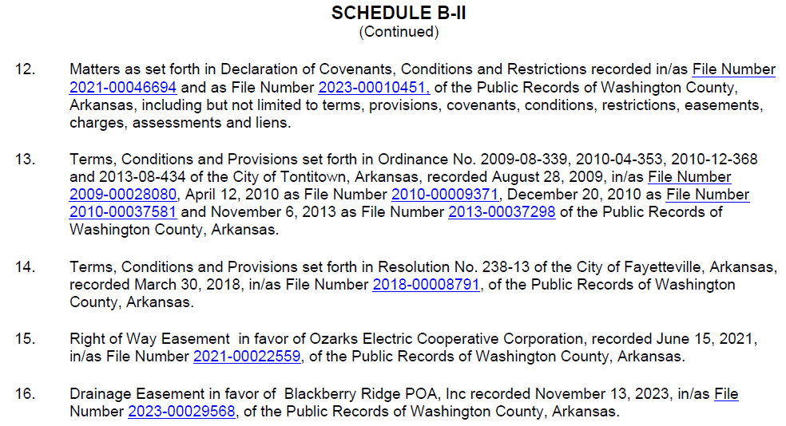
The result: a real production file
9
references linked on this file
45 Seconds
turnaround measured in seconds, not minutes or hours
0
changes to how the team orders work
Schedule B-II, with every reference now a working link
Notes:
This is a real commitment processed through the live service, file 26-3014RG. Point at the blue references on screen: the plat book and page, protective covenants, city ordinances, easements. Each one is a live link to the recorded document. The delivery email lists all twelve linked references with a one line description, so the examiner can jump straight to any source document. Walk through the three numbers: twelve references linked on this one file, turnaround in minutes, and zero change to team behavior since the whole thing runs through email. If demoing live is an option, open the actual PDF and click a link.

Slide 12
WORKFLOW 2
A title plant you can talk to
Decades of indexed county records sit in the plant, but only trained staff can pull answers out of it, one search form at a time.
The idea: put an AI agent between the person and the plant. Ask a question in plain English. The agent runs the searches, pulls the documents, and assembles the answer.
Notes:
Second example. The plant holds decades of indexed records, and the bottleneck is the interface: search forms, exact field syntax, knowledge of how additions and legals are indexed. Only experienced staff can drive it. The idea is simple: let an AI agent operate the plant on the user's behalf. The person asks a question the way they would ask a coworker. The agent translates that into the right plant searches, retrieves the documents, and assembles a usable answer. This is agentic AI in the practical sense: the model is not just answering from memory, it is using tools against your own verified data, which also keeps it grounded and keeps the token cost down.

Slide 13
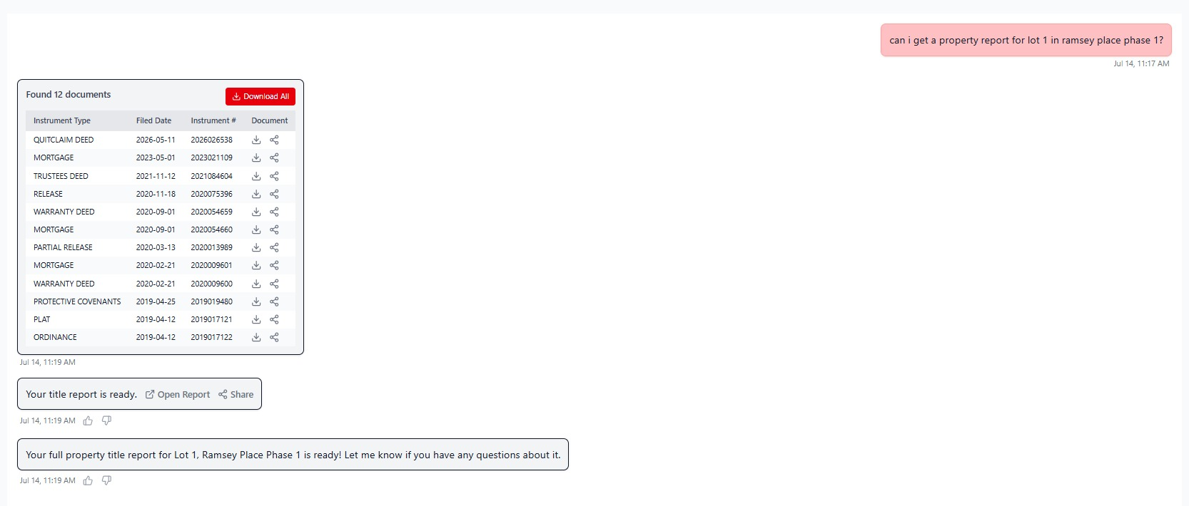
One question, full property report
"Can I get a property report for Lot 1 in Ramsey Place Phase 1?"
12 documents located, downloadable individually, plus a generated title report, in under two minutes.
Notes:
Walk the screenshot top to bottom. The user types one plain English question. The agent identifies the subdivision and lot, searches the plant, and returns every relevant instrument: the plat, protective covenants, warranty deeds, mortgages, releases, an ordinance, twelve documents in all, each downloadable. Then it generates a full property report from those documents. Point out the chat history on the left in the live product: covenants requests, plat requests, ownership questions. Staff are already using it for daily work. The punchline: the expertise to drive the plant is now encoded in the agent, so the answer takes one question instead of a trained operator and a dozen searches.

Slide 14
Where the line is
What we hand to AI, and what stays with people
AI handles
People keep
Reading and extracting from documents
Matching references to records
Classifying and indexing
First drafts and summaries
Running searches and assembling results
Examination decisions
Underwriting judgment
Anything customer facing, until reviewed
The final call when confidence is low
Accountability for the file
Our indexing workflows report a confidence score on every decision. High confidence flows through, low confidence routes to a person.
Notes:
Address the question everyone is quietly asking: does this replace people? Frame it as a division of labor. AI takes the mechanical layer: reading, matching, classifying, drafting, searching. People keep the judgment layer: exam decisions, underwriting, anything a customer sees before review, and ultimate accountability. Mention the confidence score pattern from our indexing work: every automated decision carries a confidence number, high confidence flows through automatically, low confidence lands in a human queue. In one batch of 1946 records, 92 percent came through at high confidence, and the remaining 8 percent got human eyes. That routing pattern is reusable in almost any workflow.

Slide 15
How to start in your shop
1
2
3
4
Pick one repetitive task
Define correct
Run it in parallel
Measure, then expand
Something staff grumble about that happens on every file.
Write down the input, the expected output, and how you will check it.
Let AI do the task alongside your current process. Compare results.
When the numbers hold, reduce review and pick the next task.
Each successful workflow is a building block. The hyperlinker and the plant agent share the same data foundation. The second one was much easier to build than the first.
Notes:
Give the audience a playbook. One: pick a single repetitive task, ideally one staff already complain about. Two: define correct before you automate, because if you cannot write down what a right answer looks like, you cannot evaluate the AI. Three: run in parallel with the existing process so there is zero risk while you learn. Four: measure, then expand. Close on the building block point: our hyperlinker and plant agent share the same underlying document and index data, so each workflow made the next one cheaper. Momentum compounds.

Slide 16
Thank you
Questions welcome. Happy to talk through any workflow in detail.
Patrick Curry
aboundai.com | info@aboundai.com
AI-powered data services for title and closing
Notes:
Wrap up and open for questions. If time allows, offer the live demo of either workflow. Invite anyone interested in the hyperlinking service or plant agent to come talk afterward or reach out through aboundai.com.

