Slide 1

An Ethical Duty to Protect Your Clients:
State of Wire Fraud
2026
Three years of data. One clear message.
The industry must act now.
State of Wire Fraud 2026

Slide 2
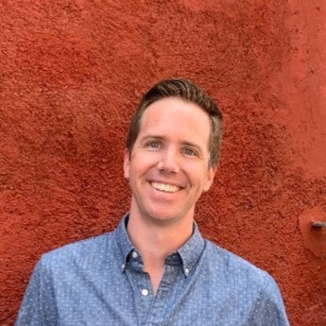

Jim Robertson
Senior Sales Manager
Notes:
10 years experience in Risk Management and Compliance
6 Years in IDV

Slide 3
Agenda
01
The scale of the threat
National cyber crime stats
04
Survey of homeowners
How consumer sentiment is evolving
The impact of AI
Deepfakes, BEC, and the new playbook attackers use
02
05
What actually works
Prevention and recovery in action
03
Real estate wire fraud
Why it’s a top target for fraudsters
06
CertifID solutions
How to stay ahead of the risk

Slide 4

Every wire transfer
is someone's life savings.
A first home. A retirement nest egg. A family's future.
When wire fraud succeeds, the loss is more than financial.
It's personal.
State of Wire Fraud 2026
Notes:
When we talk about wire fraud it’s easy to get lost in the numbers. And there are a lot of big numbers on the following slides. I’ve never worked as a title agent but I imagine the best part of your job is putting someone in a home, or facilitating the sale that
gives them money for retirement, or a refi that pays for college or lets them travel the world. That makes it so much much worse when fraud hits. You’re not losing money, you’re losing the dream.

Slide 5

Cybercrime has exploded
16
$16.6B
14
FBI-reported losses have nearly quadrupled in five years
12
$12.5B
10
$10.3B
FBI IC3 Reported Losses ($B)
8
6
$6.9B
$4.2B
4
2020
2021
2022
2023
2024
Year
Source: FBI IC3 Annual Reports 2020-2024
State of Wire Fraud 2026
Notes:
This includes all types of cyber crime, investment, romance scams, crypto, etc
Let’s talk about just business email compromise…

Slide 6

AI changed the game
What AI enables
1,760%
Perfect grammar in phishing emails
Voice cloning for phone verification
Deepfake video impersonation
increase in BEC attacks since generative AI
tools became widely available*
Scale: thousands of tailored attacks
40% of BEC emails now AI-generated
*Source: Perception Point’s 2024 Annual Report: Cybersecurity Trends & Insights
State of Wire Fraud 2026
Notes:
What does someone need to commit fraud: english speaking, with knowledge of how
to get access to your data, and how to capitalize on that access, they needed to be in
the room with you
Technology has taken down barriers
2020- remote work, virtual closings, geography was no longer a barrier
2021- Crypto goes mainstream
2022- Chat GPT access to data and information gets even easier,
2025- Apple releases live translation
Fraud has has industrialized- it is happening at scale

Slide 7







Threat Framework
From information to monetization…
Acquire
Synthesize
Weaponize
Execute
AI scrapes MLS listings, county ownership records, taxing authority data, social media profiles, and public court filings. A complete target dossier is assembled in seconds.
Large language models structure raw OSINT data into a personalized attack brief: transaction timelines, party relationships, dollar amounts, communication patterns, and psychological vulnerabilities.
The trifecta is deployed: deepfake video generated from LinkedIn photo, voice cloned from online audio, synthetic ID documents fabricated, spear-phishing emails crafted with perfect context.
Attack is timed to closing urgency. Wire instructions sent through compromised email or spoofed domain. Fraudster available via cloned voice for callback confirmation. The victim has no reason to doubt.
Tools used:
Zillow • Realtor.com • County GIS
Social media • LinkedIn • Whitepages
Tools used:
ChatGPT • Claude • Gemini
Custom fine-tuned fraud LLMs (dark web)
Tools used:
ElevenLabs (voice) • Midjourney (ID) •HeyGen (video) • GPT-4 (emails)
Tools used:
Timed to wire deadline • Urgency tactics • Voice callback confirmation • Spoofed domain
Source: CISA Threat Intelligence 2025 | Europol AI Crime Report 2025 | Recorded Future Annual Report 2025
Notes:
Industrialization brings specialization
Mention Spam compounds

Slide 8




The Trifecta of Social Engineering
What it looks like when it’s real - not theoretical.
Deepfake Video
Voice Cloning
Synthetic Identity
Generated in minutes
3 seconds of audio
AI-generated ID docs
From a single photo
99% match accuracy
Credit history fabricated
Pennies per video
$0 cost with free tools
Passes basic KYC checks
Criminals use a single image from your website or LinkedIn to generate a convincing deepfake video impersonating you in a wire instruction confirmation call.
With as little as 3 seconds of audio — from a YouTube video, podcast, or voicemail — AI can clone a voice convincingly enough to pass a phone verification call.
AI can generate photorealistic driver's licenses, passports, and financial documents. Synthetic identity fraud is the fastest-growing form of financial crime.
MIT Media Lab 2025: Deepfake generation time dropped 94% in 24 months
ElevenLabs, Resemble AI, and open-source tools are freely available
Deloitte 2025: Synthetic ID fraud projected to reach $23B in U.S. losses by 2030
Combined, these three tools create a fraud attempt that is indistinguishable from a legitimate transaction communication.
Notes:
Deepfake video gets all the headlines, but deep fake audio is available for free, at scale and it’s almost perfect. We recently hosted a webinar with a couple that had a call from their “lender” with voice spoofing in real time

Slide 9
Incidents involving deepfake video now dominate
Deepfake Video Generation
Chatbot
Autonomous Driving
Voice Generation
Image Generation
Face Recognition
Deepfake Image Generation
200
160
Deepfake-enabled fraud and social engineering attacks now outnumber all other AI incident types combined
120
80
40
0
2018
2019
2020
2021
2022
2023
2024
2025
Source: MIT AI Incident Tracker (as reported by Time Magazine)
State of Wire Fraud 2026
Notes:
Look at how the threat has shifted.
The data
Before 2023: top incidents were autonomous vehicles, facial recognition, content moderation
Now: deepfake video outnumbers all three combined
Scam-related AI incidents: up 8x since 2022
Why it matters from title
Criminals can clone a voice from a short audio sample
A "call from your client" may not be your client
Old verification methods are becoming obsolete
The point
This isn't AI making mistakes, it's AI enabling fraud
Deepfakes exploit trust, just like social engineering always has
Difference: now it's scalable, convincing, and cheap
It used to be the phrase “warmly” or “kind regards” we cant rely on these signals any more
Takeaway
Assume voices and videos can be faked
We need verification that doesn't rely on humans spotting fakes
Source
Time Magazine (January 2026), AI Incident Database

Slide 10




Looking ahead: Next Gen Risks are in Development
Autonomous AI agents
Undetectable synthetic identities
End-to-end fraud campaigns executed without human involvement — from reconnaissance to wire interception
AI-generated personas with consistent history, credit records, and social media presence that pass all traditional checks
Multi-Party Infiltration
Fraud-as-a-Service
Next-gen attacks will compromise all parties simultaneously - coordinating a multi-front deception that is virtually impossible to catch through manual verification.
Turnkey attack toolkits become widely accessible, lowering the barrier to entry for sophisticated fraud schemes
Foundational readiness — people, process, and technology — matters more than chasing individual tools.
Notes:
Autonomous Agents-
Prospecting agent hands off to a fishing agent- to a communication agent
Fraud as a service-
Industrialization leads to specialization

Slide 11





Real estate is ground zero
The perfect combination of vulnerabilities
High-value transactions
Time pressure
Multiple parties
Median home price exceeds $400K. Commercial deals reach millions.
Tight closing deadlines create urgency that criminals exploit.
Buyers, sellers, agents, lenders, title—endless impersonation targets.
Public information
Fragmented security
Listings, records, and transaction details are publicly accessible.
No unified standards. Practices vary wildly by state and company.
State of Wire Fraud 2026
Notes:
Willie Sutton- why do you rob banks

Slide 12





Wire Fraud in Alabama.
$167M
9,936
$340k
in total reported losses
complaints
in average losses reported to CertifID’s FRS Team
#28 in the US
#27 in the US
Based on 2025 Fraud Recovery Data
State of Wire Fraud 2026
Source: 2025 FBI IC3 report

Slide 13
Three years of tracking
this problem
The State of Wire Fraud: 2024, 2025, and now 2026
State of Wire Fraud 2026
Notes:
Let’s tie this back to ethics

Slide 14
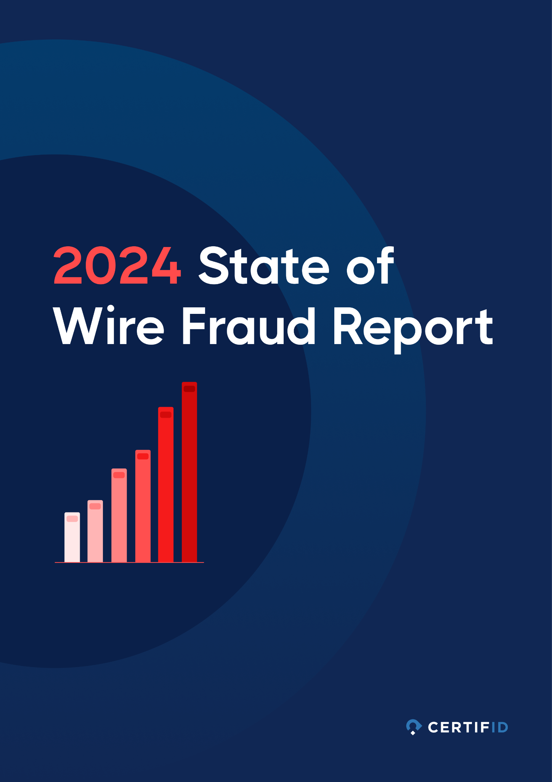
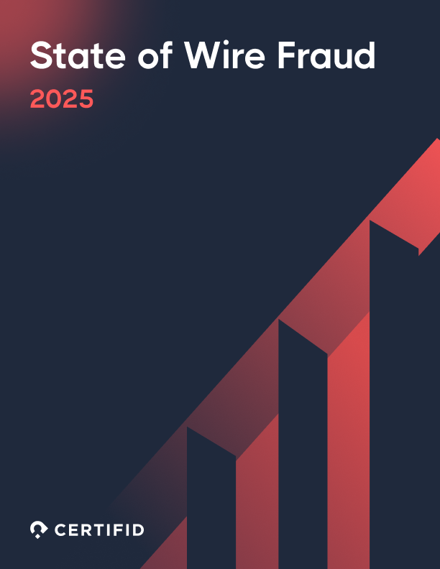
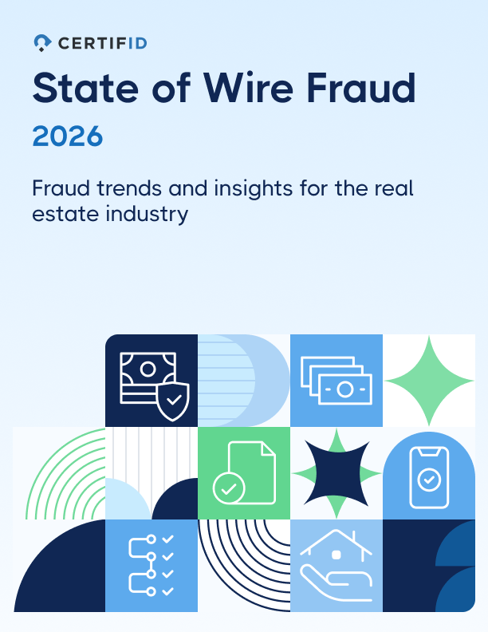



The picture gets clearer every year
2024
2025
2026
We sounded the alarm
The threat accelerated
The picture is now clear
799K transactions protected
913K transactions
1.46M transactions protected
FBI reports cybercrime losses hit $16.6B
FBI expects record-breaking losses in 2026 due to AI & BEC threats
FBI reports cybercrime losses hit $12.5B
71% consumers said it’s industry responsibility to educate them on wire fraud
Industry raises need for best practices for identity verification
Consumers say proactive protection beats education 3:1
78% of consumers cite willingness to pay extra for fraud protection
85% of consumers cite willingness to pay significantly for fraud protection
51% of consumers “somewhat” or “not aware” of wire fraud risks
BEC +
AI growth +
Agentic AI
State of Wire Fraud 2026
Notes:
We have protected substantially more transactions year over year, yet the fraud numbers keep going up
Consumers wanted education, the industry started giving it to them, and it wasn’t enough. Fraud numbers keep going up and now consumer want proactive protection
Jump back 2 years ago, half of your clients were not aware of the risk of wire fraud, now
they know the danger and they are willing to pay for prevention (and pay more than you think)

Slide 15
What we found in 2026
New data from 1,400+ real estate professionals and consumers
State of Wire Fraud 2026

Slide 16


82%
have personal or secondhand
fraud experience
22%
61%
felt their funds could
be at risk
of homebuyers received fraudulent
or suspicious communications
during their transaction
46%
delayed sending funds
due to security concerns
Nearly 1 in 4 consumers are directly targeted.
State of Wire Fraud 2026

Slide 17

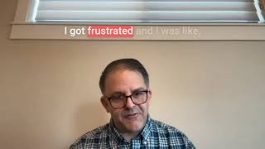
Notes:
1 min 38 seconds

Slide 18

Title professionals see it every day
60%
73%
58%
say fraud is
increasing
say attacks are more
sophisticated
encounter suspicious
activity quarterly
Only 7% report decreases
AI-powered, contextual, convincing
It's not rare—it's routine
State of Wire Fraud 2026

Slide 19
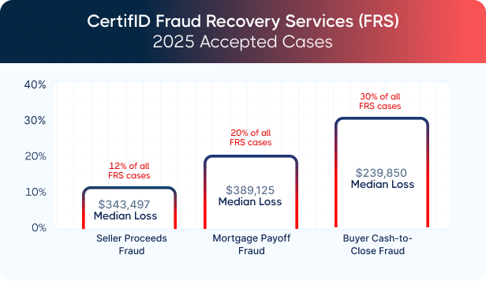
Not all fraud is the same
CertifID Fraud Recovery Services data reveals three primary categories
20% of cases
Buyer Cash-to-Close
Criminals impersonate title companies and send fraudulent wire instructions to first-time buyers.
Mortgage Payoff
Forged payoff statements redirect mortgage funds. The highest median loss of any category.
Seller Proceeds
Criminals impersonate sellers and redirect the proceeds of home sales to their own accounts.
State of Wire Fraud 2026
Notes:
Explain FRS- Our team works directly with Law Enforcement and banks to freeze accounts and expedite return of funds
This comes from our recovery teams accepted cases
Buyer- low hanging fruit
Mortgage payoff biggest prize

Slide 20
The #1 threat ahead:
Seller impersonation
42% of title professionals view seller impersonation as the biggest risk ahead—significantly more than any other fraud type.
Highest-risk
Seller impersonation
42%
Transaction type:
Proceeds/disbursement fraud
28%
Vacant Land
Payoff fraud
22%
60% of title pros report elevated
fraud in vacant land transactions
Buyer-side fraud
9%
Source: CertifID Title Professional Survey, n=153 | 2025
State of Wire Fraud 2026

Slide 21
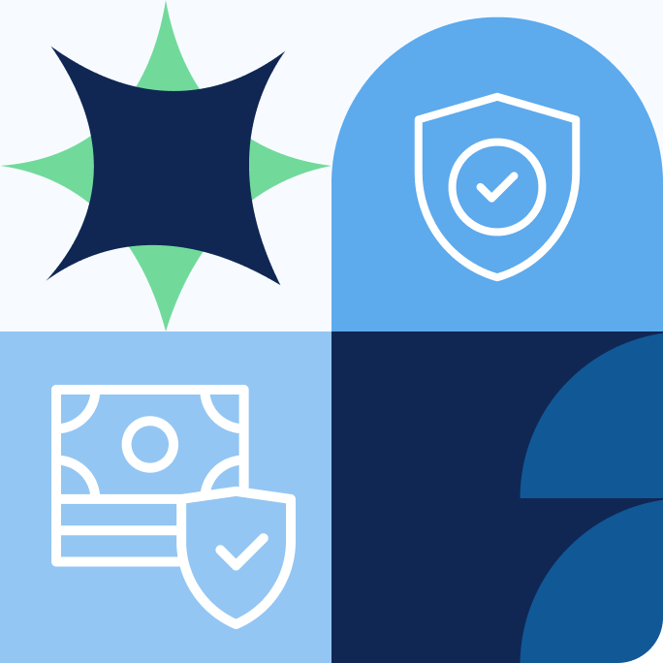
Consumers have changed
They know the threat is real. They're asking what you're doing about it.
State of Wire Fraud 2026

Slide 22
Consumers are not naive
AI awareness by age
82%
Ages 30-39
88%
Ages 18-29
85%
of consumers are aware criminals use AI
to impersonate real estate professionals
Ages 40-49
84%
Ages 50-59
72%
Ages 60+
66%
They know AI is a weapon. They're looking for protection, not just awareness.
State of Wire Fraud 2026
Notes:
What do people want- The want reassurance, they want protection
Infrequent transaction, large sum of money, no muscle memory, lot of parties
communicating,

Slide 23
What builds trust?
We asked consumers what would make them trust their real estate professionals more
Insurance / guarantee against fraud
48%
Mandatory verification of all parties
36%
Verified platform for wire transfers
29%
Regular security updates
28%
Accountability (insurance, verification) beats education 3:1 as a trust builder
State of Wire Fraud 2026
Notes:
Mandatory verification of all parties (starting to see this at the state level in VA and
AZ)

Slide 24
Security is a competitive advantage
What they'll pay
85%
$51 - $100
28%
$101 - $200
27%
of consumers will pay extra
for wire fraud protection
More than $200
17%
Up to $50
14%
Only 14% refuse to pay anything at all. This is active demand, not reluctant acceptance.
Nothing extra
14%
State of Wire Fraud 2026
Notes:
42% will pay over $100

Slide 25
The education gap
1 in 5
But here's the opportunity:
consumers receive zero wire fraud education from any real estate professional
74%
Who educates (when it happens)
Real estate agent (early)
30%
of consumers would be more likely to choose a firm that proactively educates them about fraud
Title company (early)
14%
Education isn't the top trust builder—
but the gap creates a clear competitive
opportunity for those willing to lead.
Other (lender/attorney)
15%
No one
20%
State of Wire Fraud 2026

Slide 26
Fraud protection protects relationships
The risk
The opportunity
56%
68%
unlikely to work with a company
again after a fraud incident
even if got the funds returned
would be strongly influenced by
guaranteed fraud protection
The gap between losing clients and winning them is narrower than you think.

Slide 27
What works
CertifID's impact on the industry—by the numbers
State of Wire Fraud 2026

Slide 28
CertifID platform impact
2024 Report
2025 Report
2026 Report
799K
913K
1.46M
$283M
transactions
transactions
transactions
protected
1,018
fraud attempts blocked in 2025 alone
State of Wire Fraud 2026
Notes:
Confirmed fraud attempts
Jefferson
6
Madison
2
Tuscaloosa
2
Baldwin
1
Mobile
1
St. Clair
1

Slide 29




Title professionals see it every day
90%
94%
3/4
rate CertifID as effective or very effective
agree CertifID
helps keep pace
with evolving fraud
use CertifID on every single transaction
Avg score: 4.55 / 5
71% strongly agree
As first line of defense
Source: CertifID Title Professional Survey, n=153 | 2025
State of Wire Fraud 2026

Slide 30
When fraud happens, we recover
CertifID Fraud Recovery Services — recovery should never be the plan, but it can be the safety net
Since 2021
773
$118M
69%
victims supported
recovery rate
recovered
State of Wire Fraud 2026
Notes:
At CertifID we like to talk about layers of protection
Education
Verification
Insurance
Recovery

Slide 31
Fraud recoveries in Alabama.
Speed is the difference between recovery and loss
in 2025
$467k
$250k
50%
total loss reported
recovery rate
recovered
State of Wire Fraud 2026

Slide 32

Notes:
5 min 23 seconds

Slide 33
A recovery story
$648,815 - Recovered in 14 days
What happened
What CertifID did
A Florida title company wired $648,815 to what appeared to be the seller's attorney—same name, firm address, and official letterhead. The only difference: the routing numbers were fraudulent.
Standard callback verification failed because the phone number connected to the criminals, not the real attorney.
Referred through their insurer, the company engaged CertifID FRS. The team escalated through its U.S. Secret Service partnership, reached the receiving bank directly, and guided issuance of a Letter of Indemnity.
Two weeks later, nearly 100% of funds were returned—minus approximately $20.
Nov 26
1 hour
Dec 4
Dec 18
Fraud occurs
Discovered
FRS engaged
Funds returned
Recovery: 99.99% | The owner, working from home with a two-month-old, described screaming with relief.
State of Wire Fraud 2026

Slide 34

What this means for you
01
Wire fraud isn't rare
1 in 4 consumers are targeted. 82% have fraud exposure. This is an industry-wide crisis.
02
The threat is evolving faster than defenses
AI-powered attacks are surging. 73% of pros say fraud is more sophisticated.
03
Consumers demand protection
85% will pay for it. 68% will choose you because of it. 56% will leave you without it.
04
Prevention is a competitive advantage
Insurance, verification, and secure platforms beat education 3:1 as trust builders.
05
Recovery works—but can't be the plan
69% recovery rate is industry-leading. But $118M recovered means $118M was stolen first.
State of Wire Fraud 2026

Slide 35

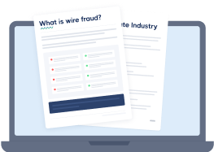
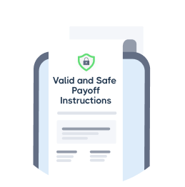


Protection requires a layered approach.
Education
Procedures
Educate key internal and external audiences
Maintain updated standard operating procedures
Enable decision making and improve efficiency with technology
Implement and test response planning to increase chances of recovery
Understand your coverage and consider first-party insurance to protect you from loss
Technology
Incident Response
Incident Response
Insurance
State of Wire Fraud 2026

Slide 36

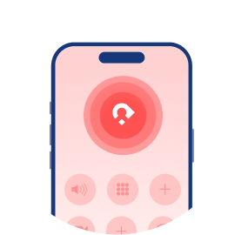
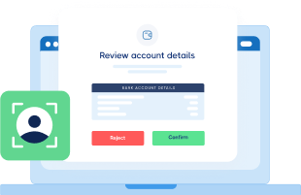
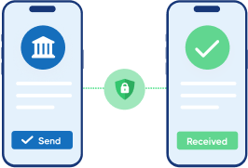
What We Do
CertifID offers a comprehensive wire fraud protection system, not just a point product.
Trusted party verification
Secure digital payments
Up to $5M in direct insurance
A dedicated fraud recovery team
Verify identities, confirm and order payoffs, securely exchange wire details and documents.
Eliminate the risk of wires getting diverted to fraudsters.
Confidence that you’re protected, no matter what.
Expedited incident response when victims need it most.
State of Wire Fraud 2026

Slide 37
Questions?

Slide 38
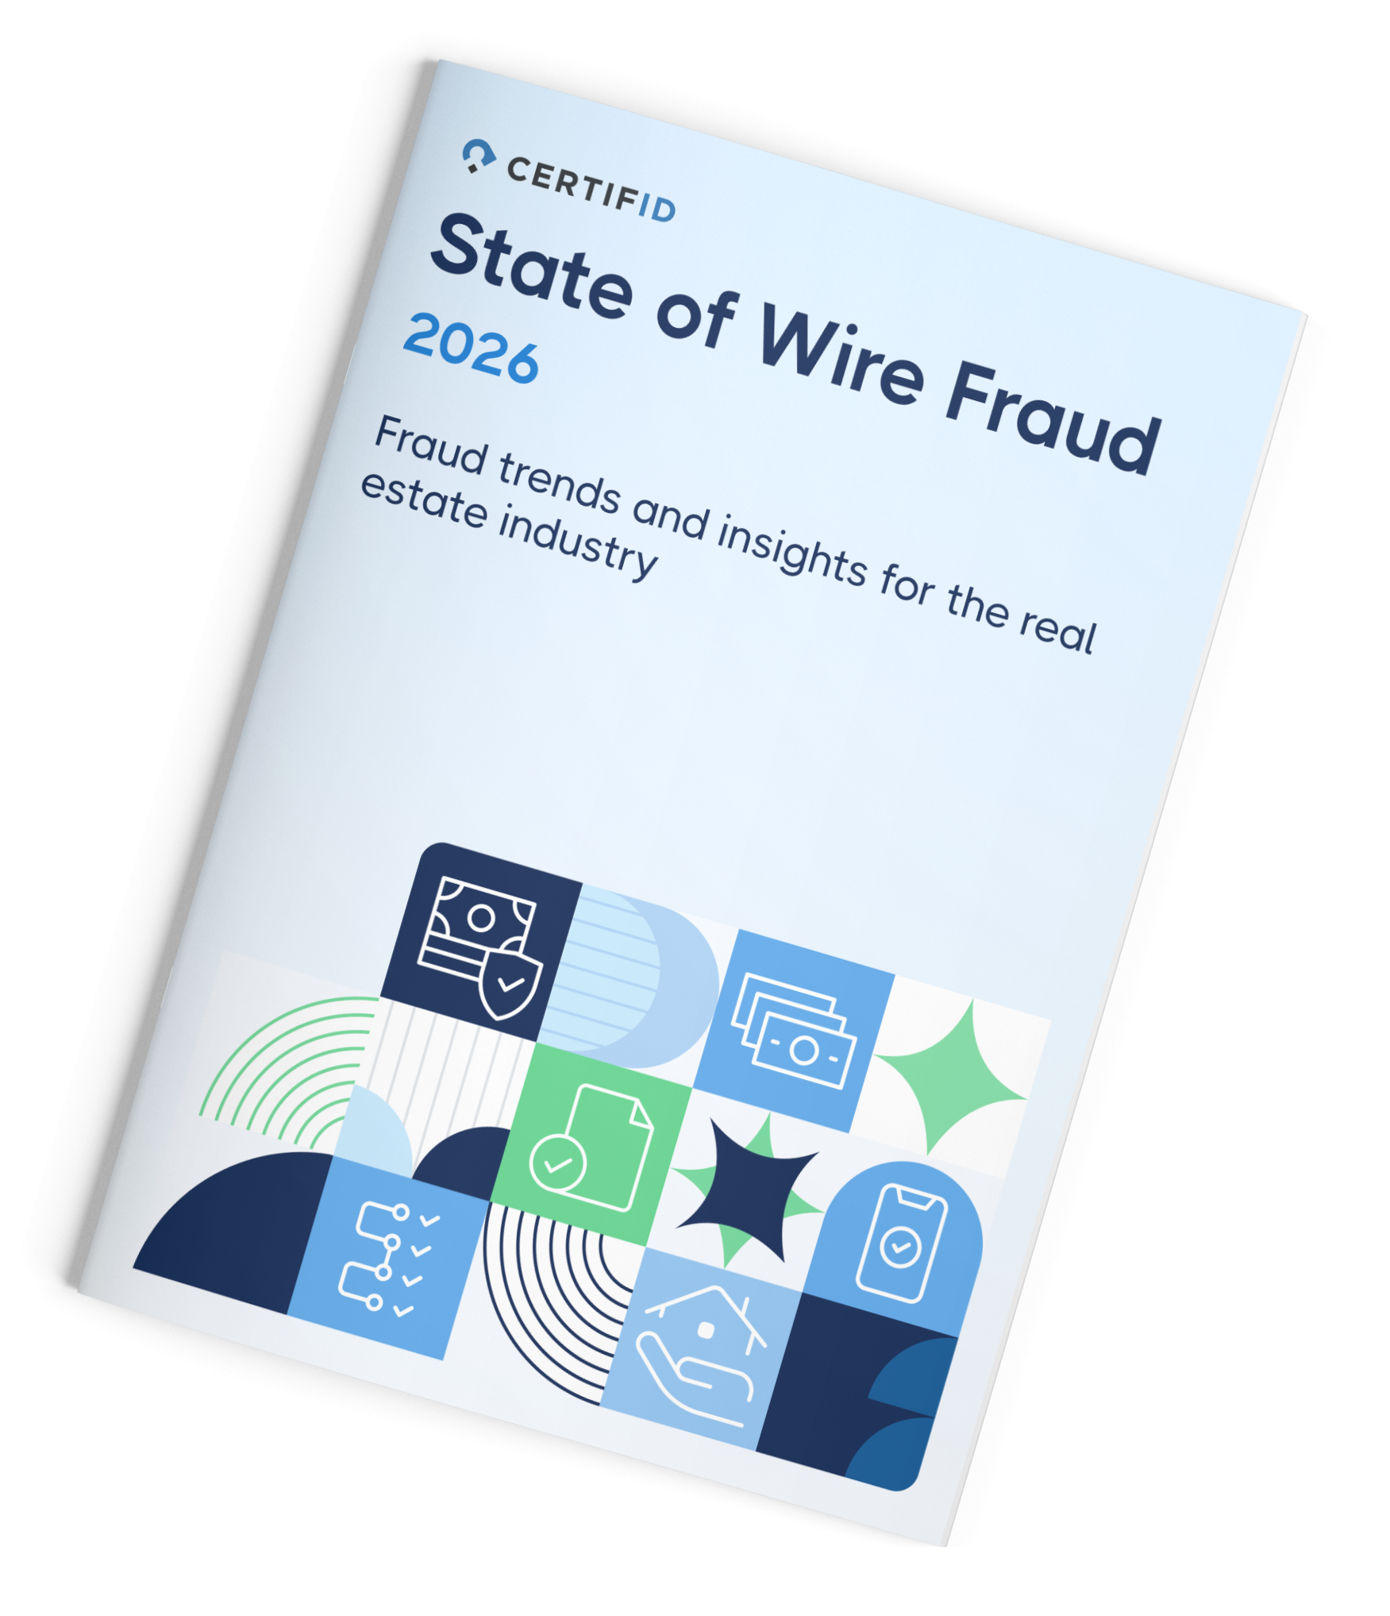
Every transaction
is someone's future.
Let's protect it.
State of Wire Fraud 2026

Slide 39
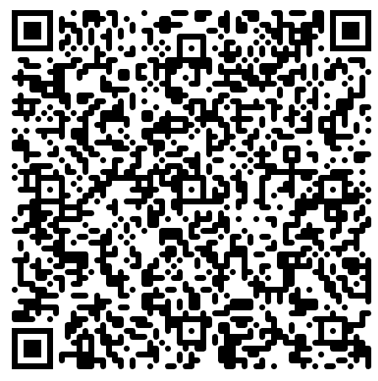
Schedule a Demo
Learn more about your benefits →
certifid.com/request-a-demo
Jim Robertson
Senior Sales Manager
jrobertson@certifid.com

Slide 40


