Slide 1
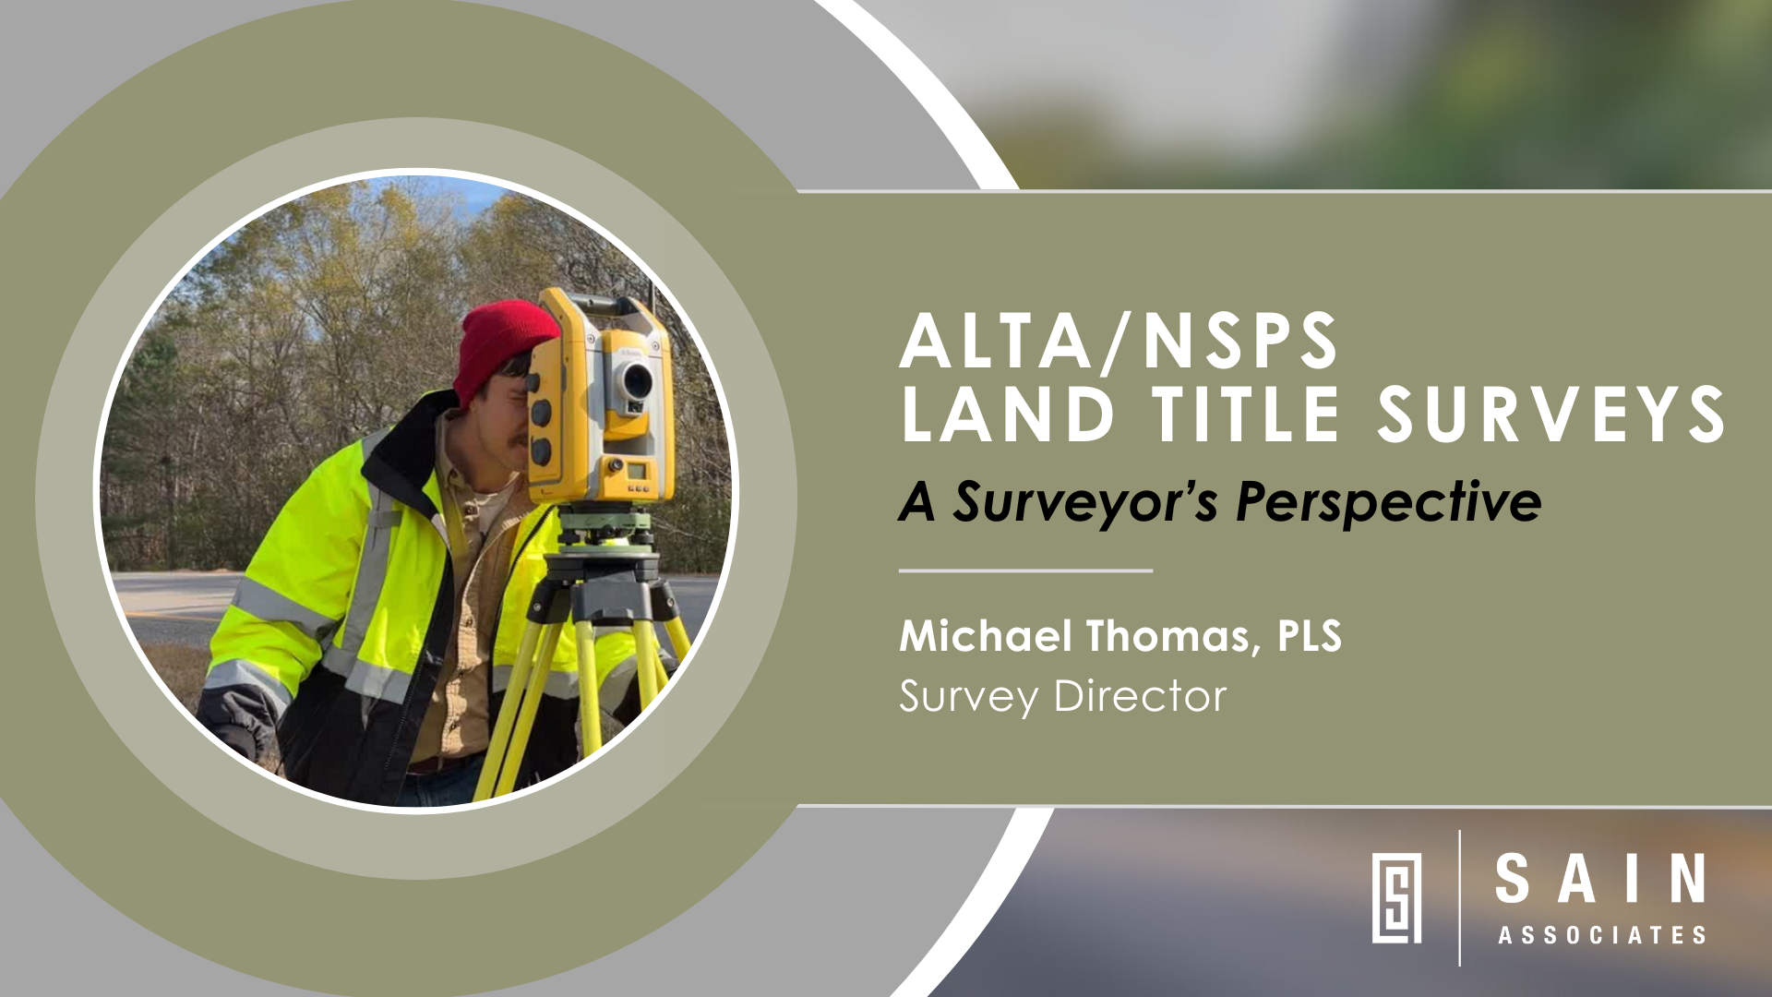

Notes:
Good afternoon. (Breathe).
I’m Michael Thomas, and I am a Professional Land Surveyor. I am also the Survey Director at Sain Associates. (Breathe).
Sain Associates is a multi discipline engineering and land surveying firm headquarter in Birmingham, AL. I started surveying in the summer of 1999. Over my career at the 3 firms, I have had the opportunity to survey in multiple states and perform a variety of surveys from residential to underground.

Slide 2
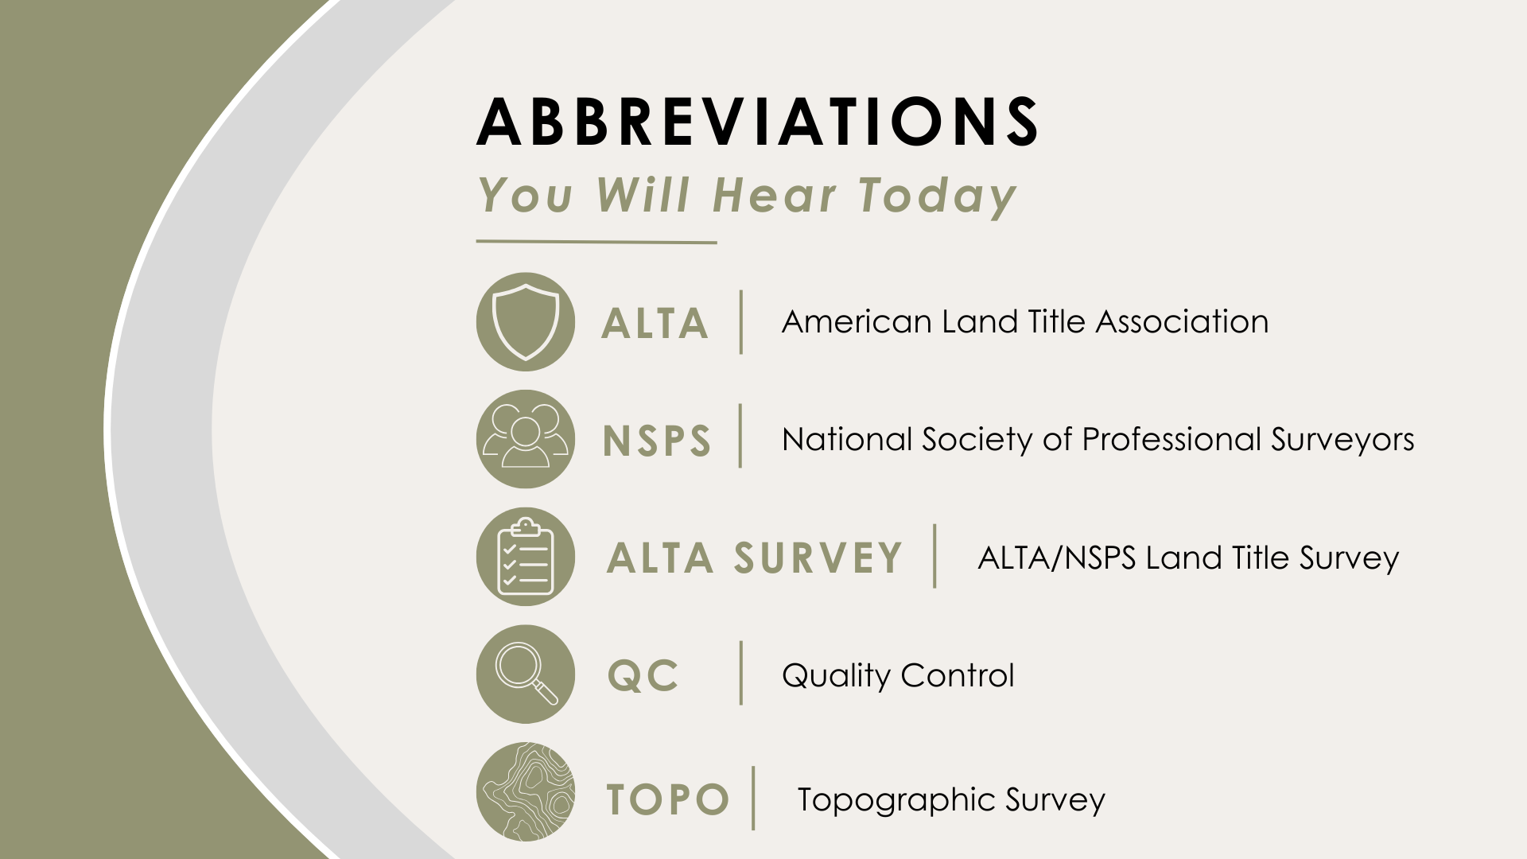
Notes:
As we talk about surveying today, you may hear me use some abbreviations, so here is a cheat sheet of terms I may use today.

Slide 3
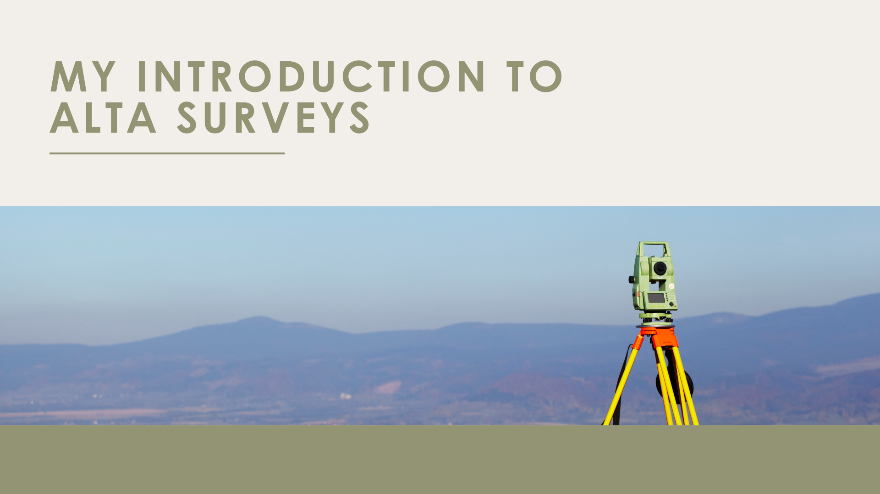
Notes:
You may be wondering, why am I talking about ALTAs today?
I was just a field guy the first time I worked on an ALTA Survey, and the land surveyor gave me about 800 pages of deeds. He asked me to sort through the paper to find relevant information.
This was my introduction to ALTAs, and I was hooked.
ALTA Surveys are challenging because of the amount of detail required. I enjoy the process and research that ALTA requires. I also really like working toward the unique standards of an ALTA.

Slide 4
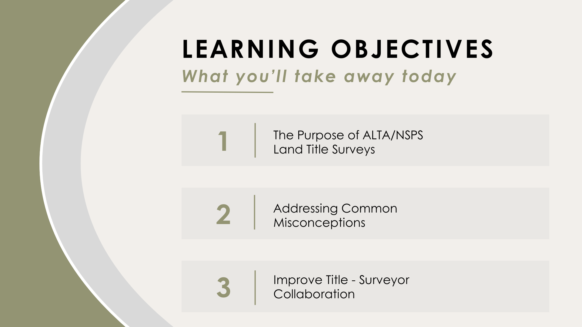
Notes:
Today’s Session goal is to give you a practical understanding of ALTA/NSPS surveys from a surveyor’s perspective. We will discuss the purpose of ALTA’s, address common misconceptions, and discuss how to improve collaboration.
Please ask questions as we go through the presentation.

Slide 5
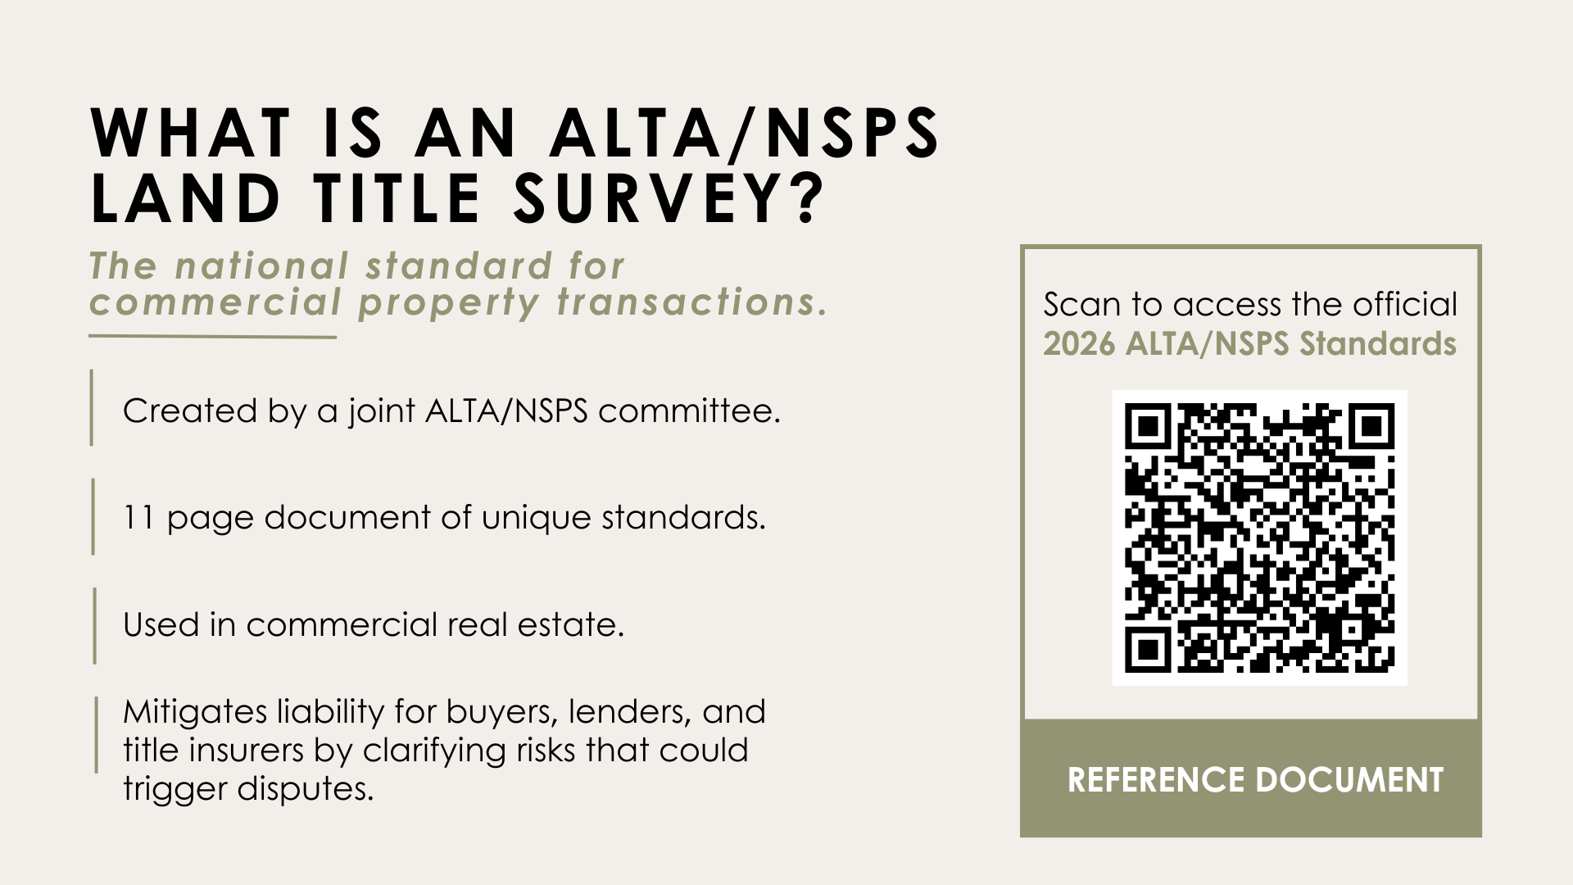
2026 ALTA/NSPS Standards

Slide 6
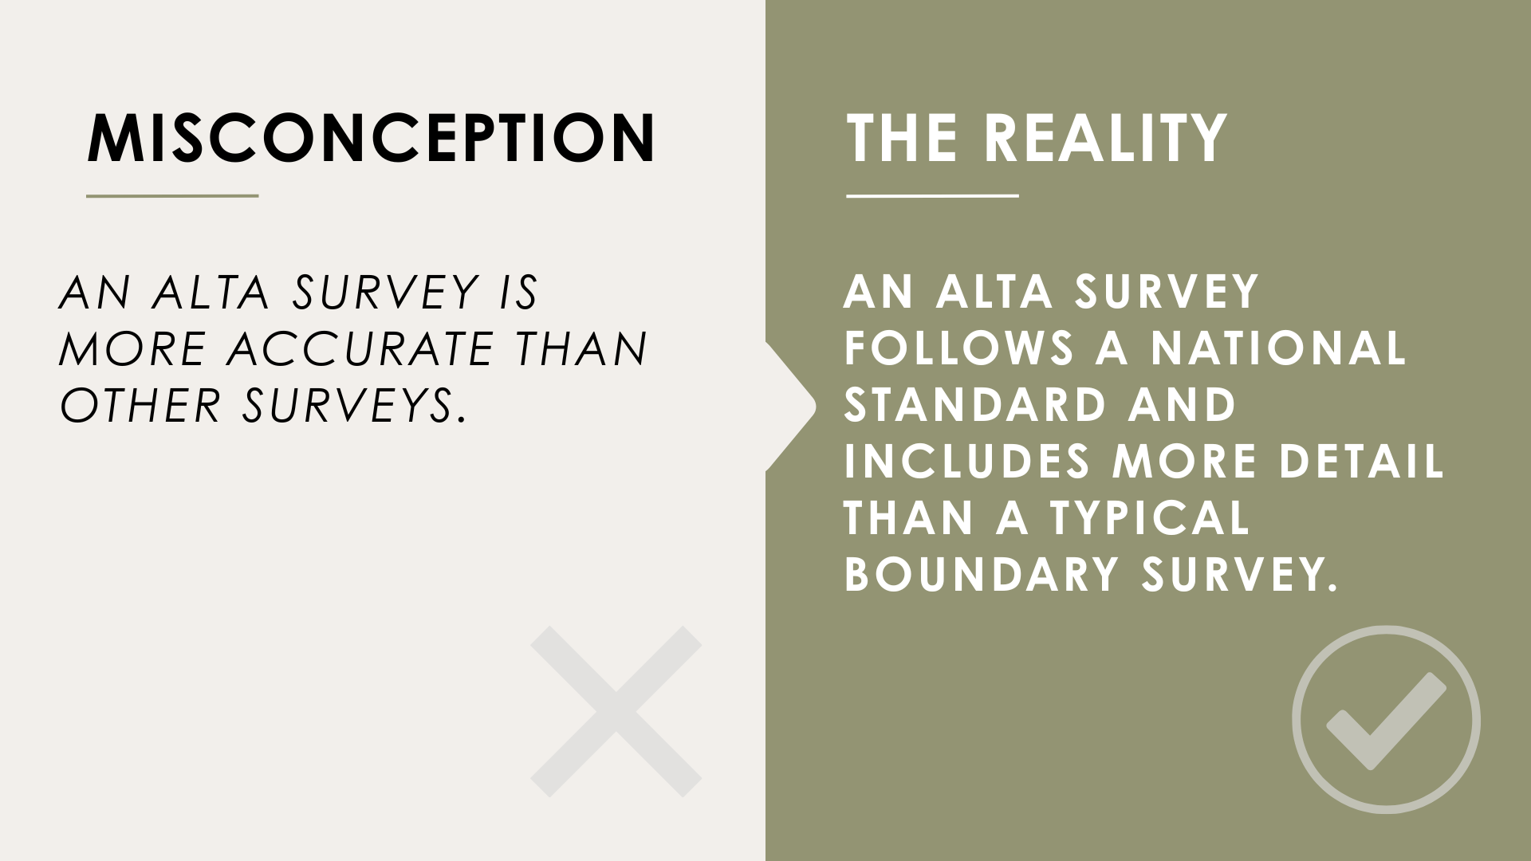
Notes:
CY Feedback: Clarify more, be more precise. Workshop slide a bit more.

Slide 7
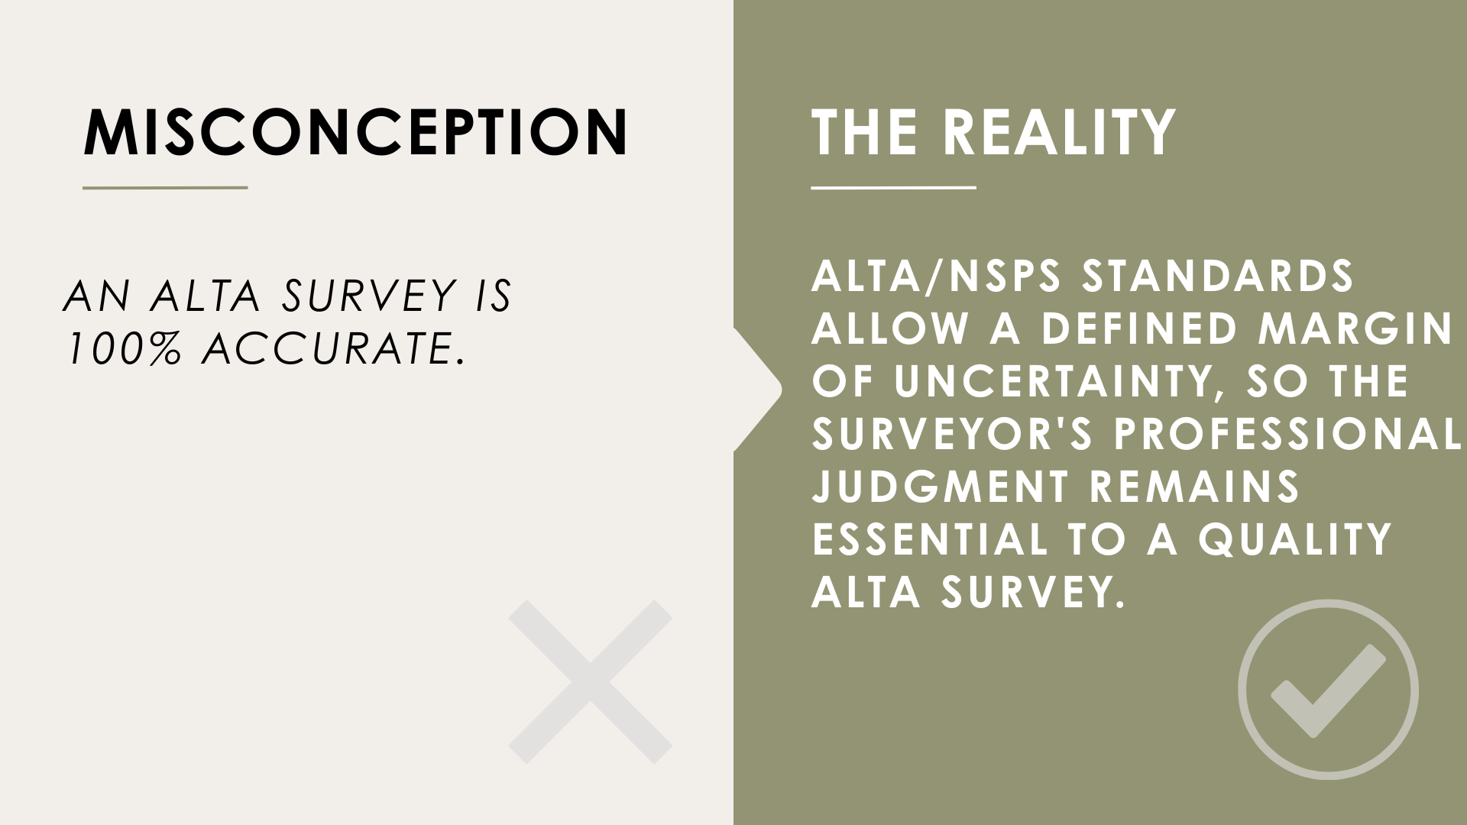
Notes:
CY Feedback: don't focus just on human error. This slide needed some work to make it stronger and clearer. I liked the mention of modern technology, bearings that vary, and operating at 95% confidence according to the standards.

Slide 8
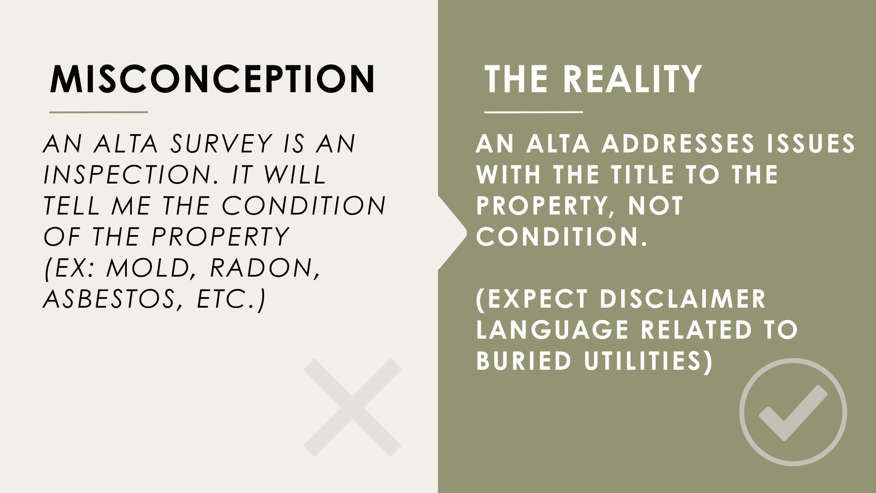
Notes:
A common misconception is that an ALTA survey is an inspection. It is not.
For instance, we may note observable features on the property, like there is trash on the site. But, that is not an inspection. We are just noting items present on the site that are observable.

Slide 9
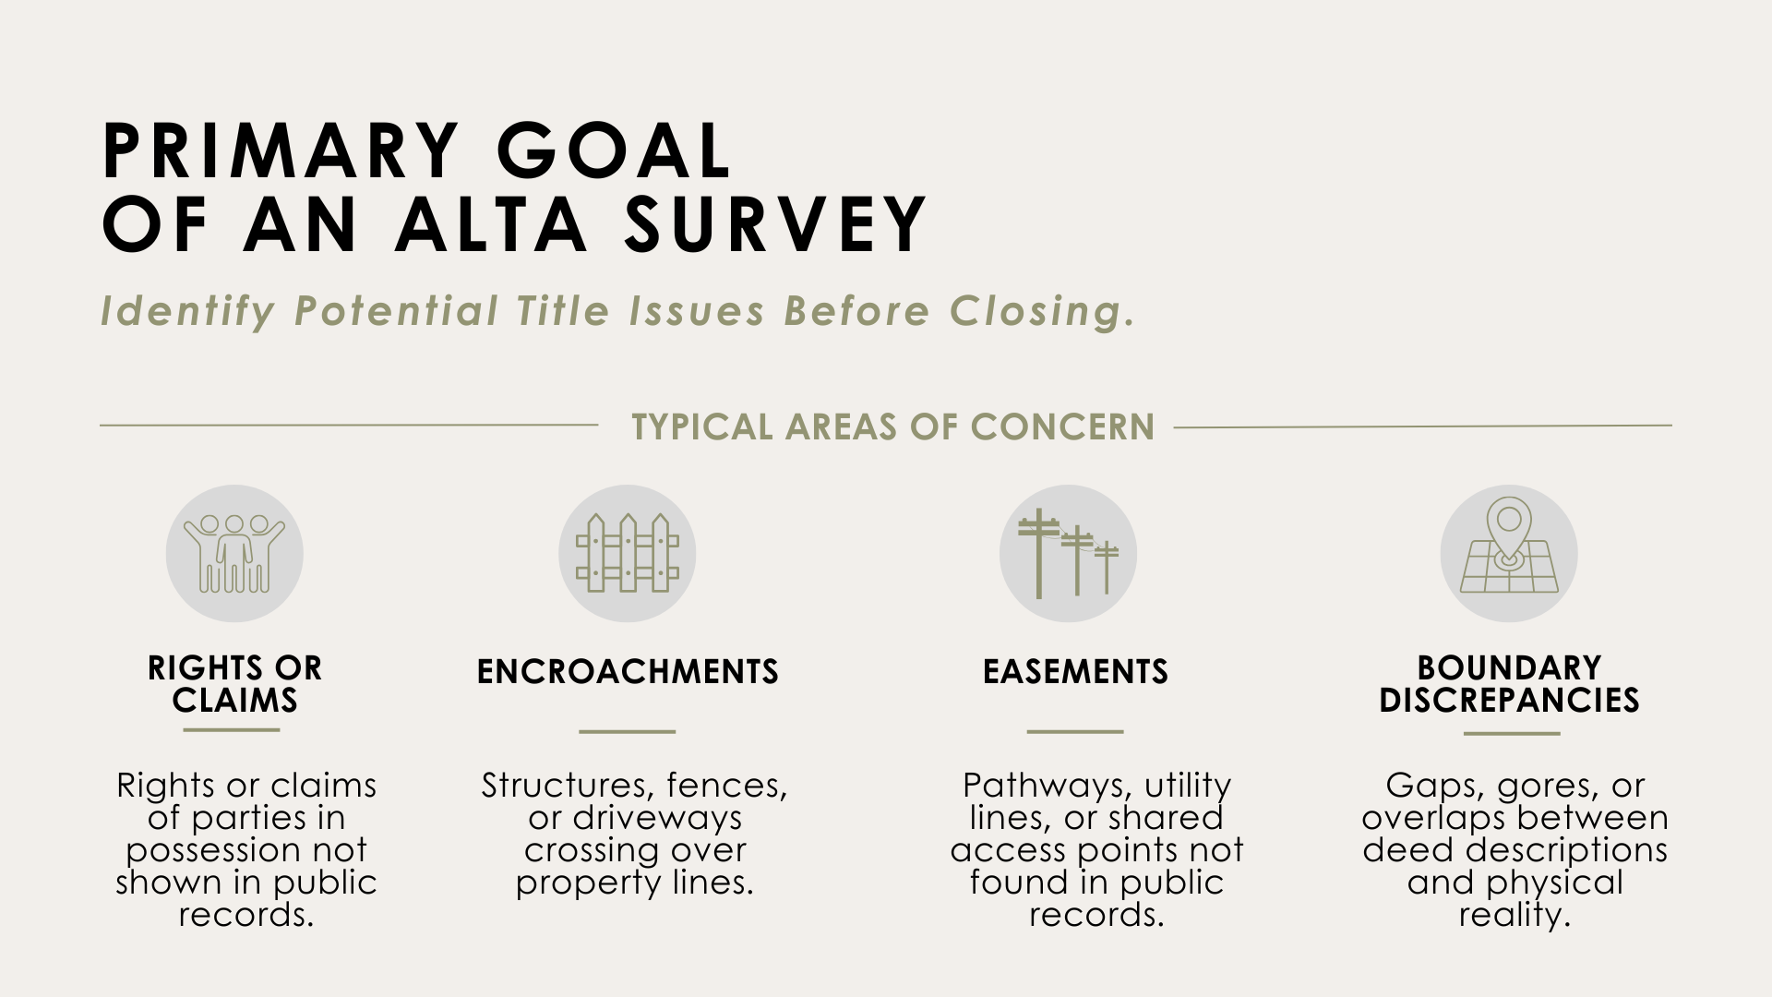
Notes:
CY Feedback: Enjoyed mentioning the story that has been passed down.

Slide 10
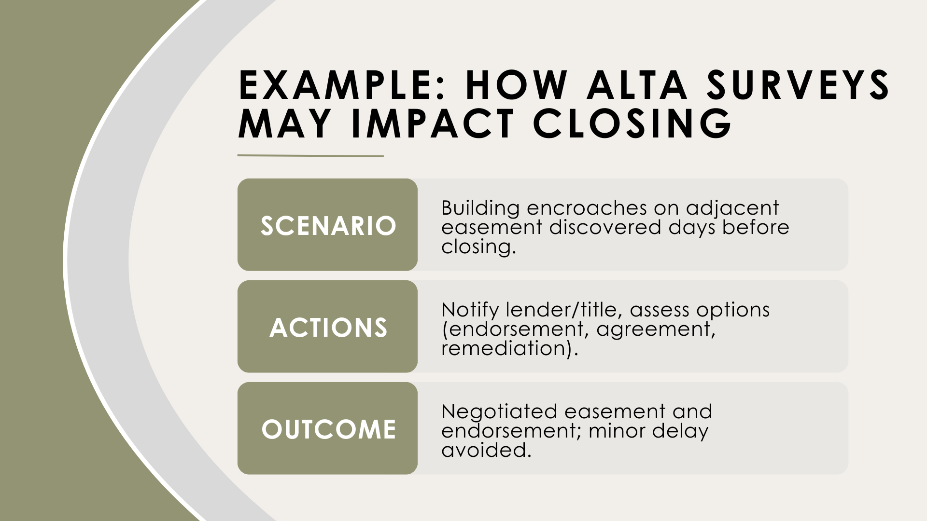

Slide 11
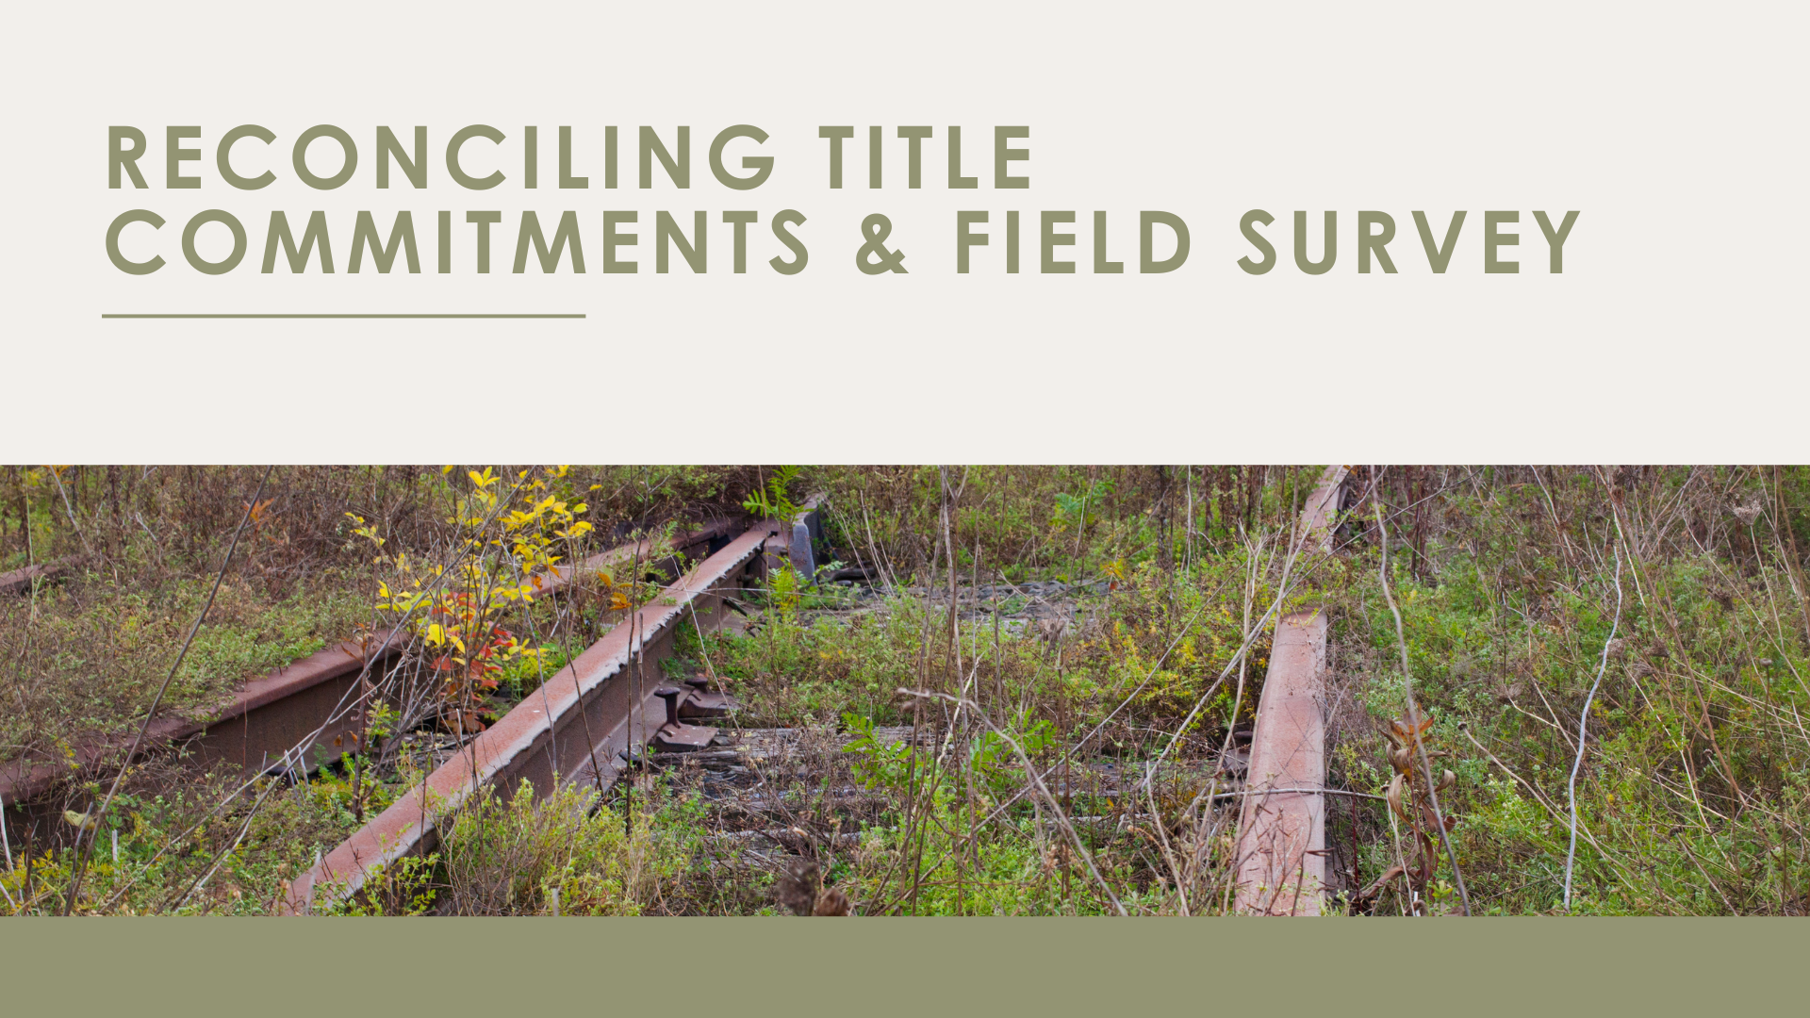
Notes:
Share story about ALTA you completed where there was an unexpected abandoned railroad in the property.
Discuss the purpose and responsibility of a surveyor.
--
CY Feedback:
Write a transition sentence to jump into this slide that will help you get into the content. Then lead into the story with a transition phrase like, For Example, . . .
I didn't know what spur lines were.
End slide with the fact that ALTAs require communication between you and the attorney.

Slide 12
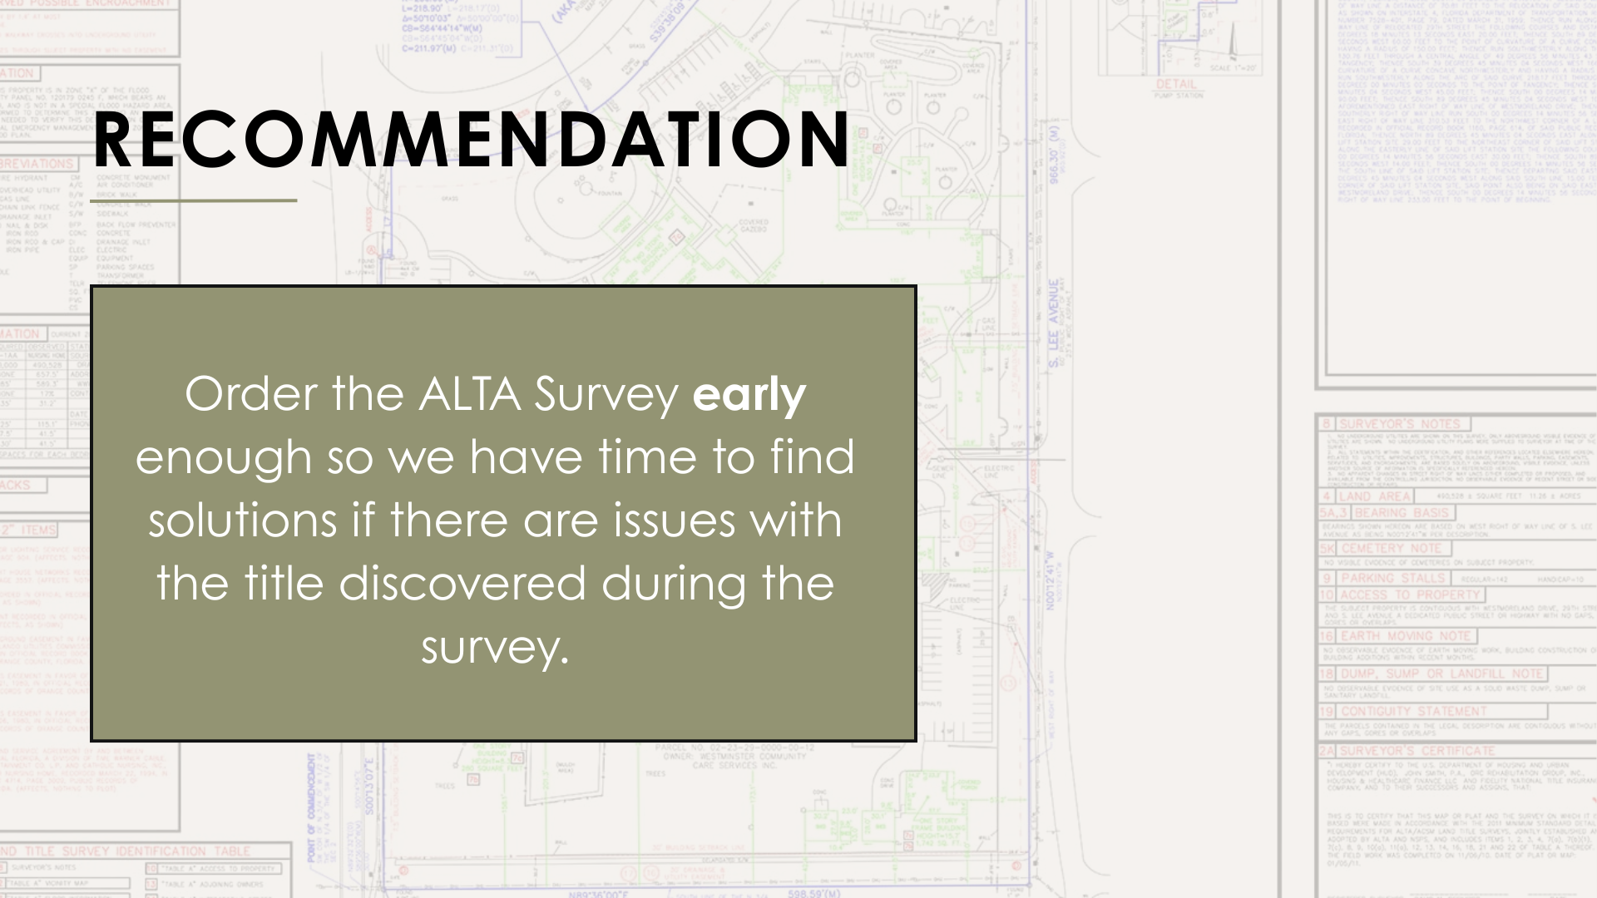

Slide 13
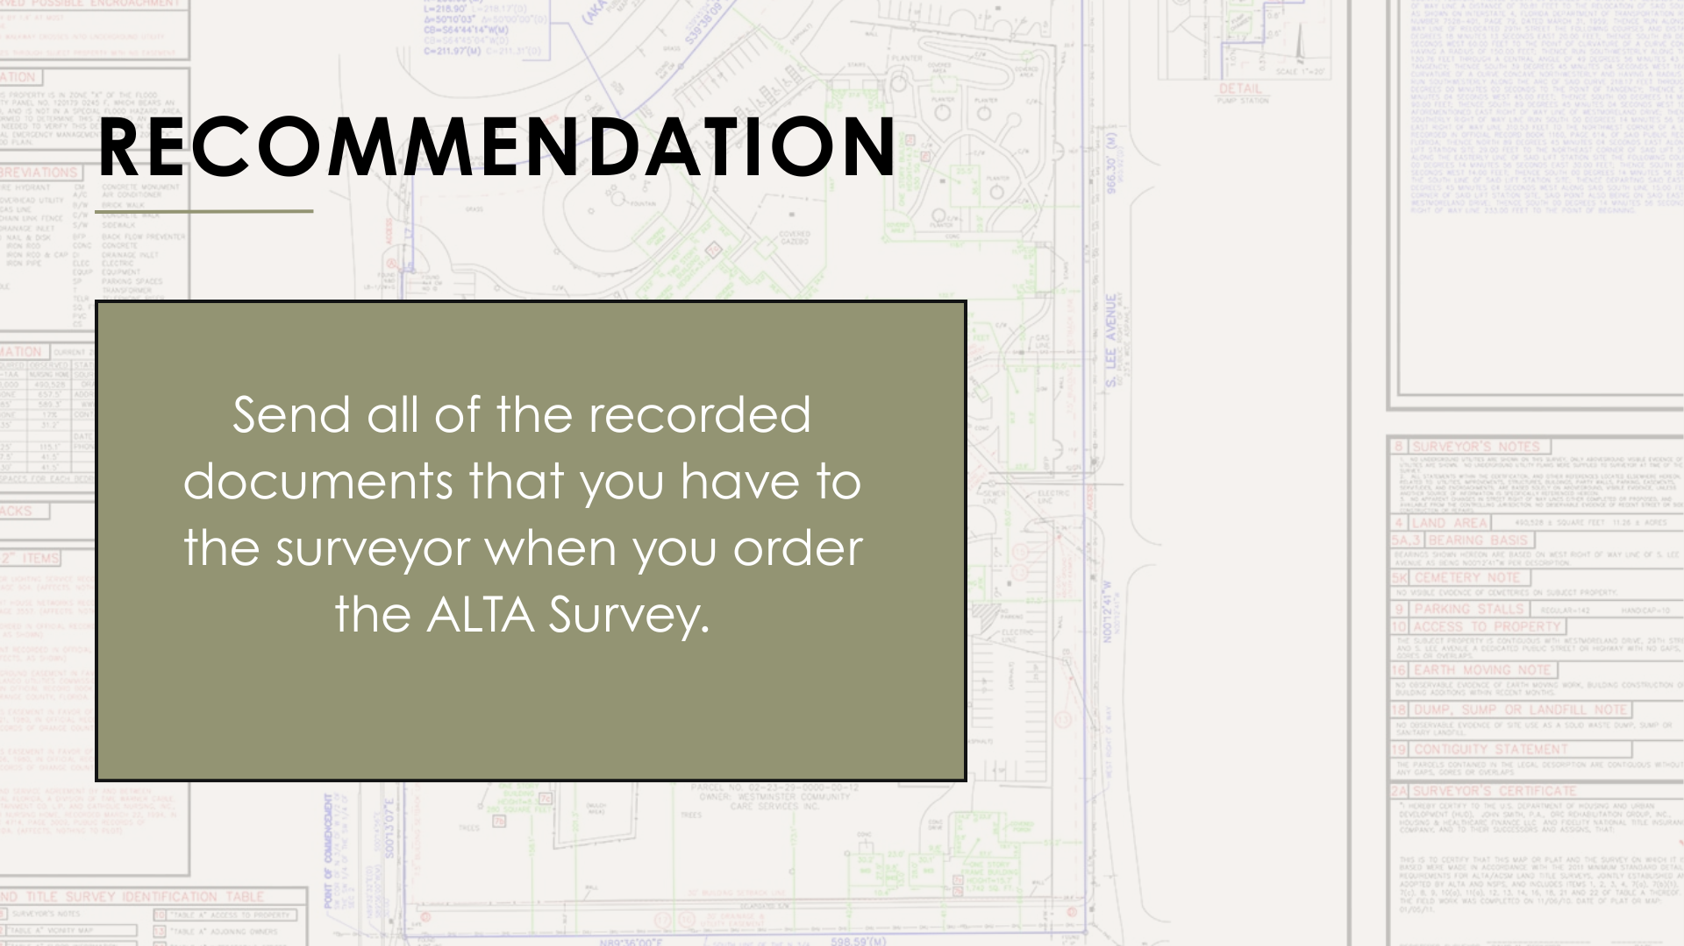
Notes:
In an ideal world, you would send Title commitments at the time of the order. However, we don't live in a perfect world. Send as much information that you have.
The more information upfront, the more efficiently we can move. We can also avoid potential rework issues as well as meet deadlines.
Items I am looking for include . . . (List here)

Slide 14
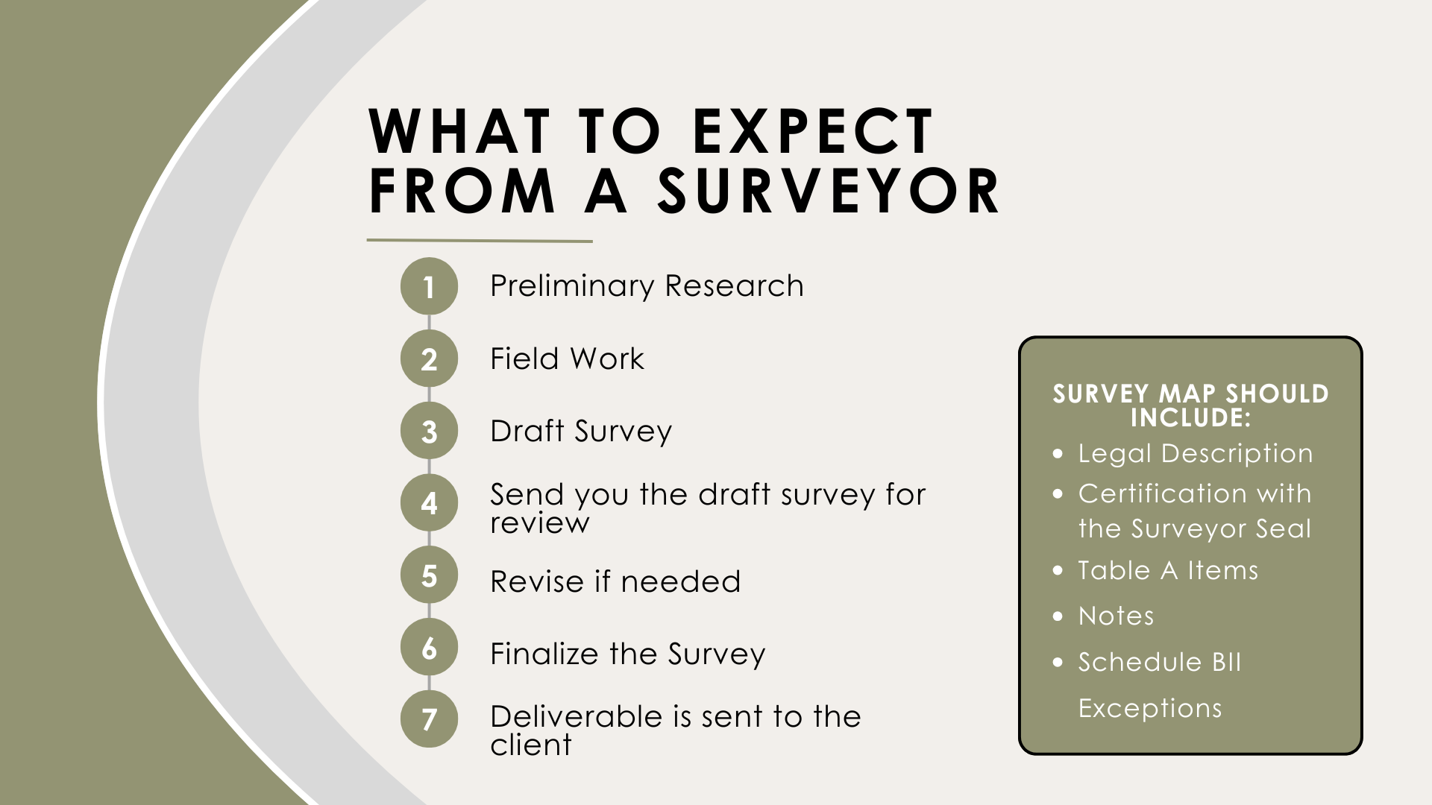

Slide 15
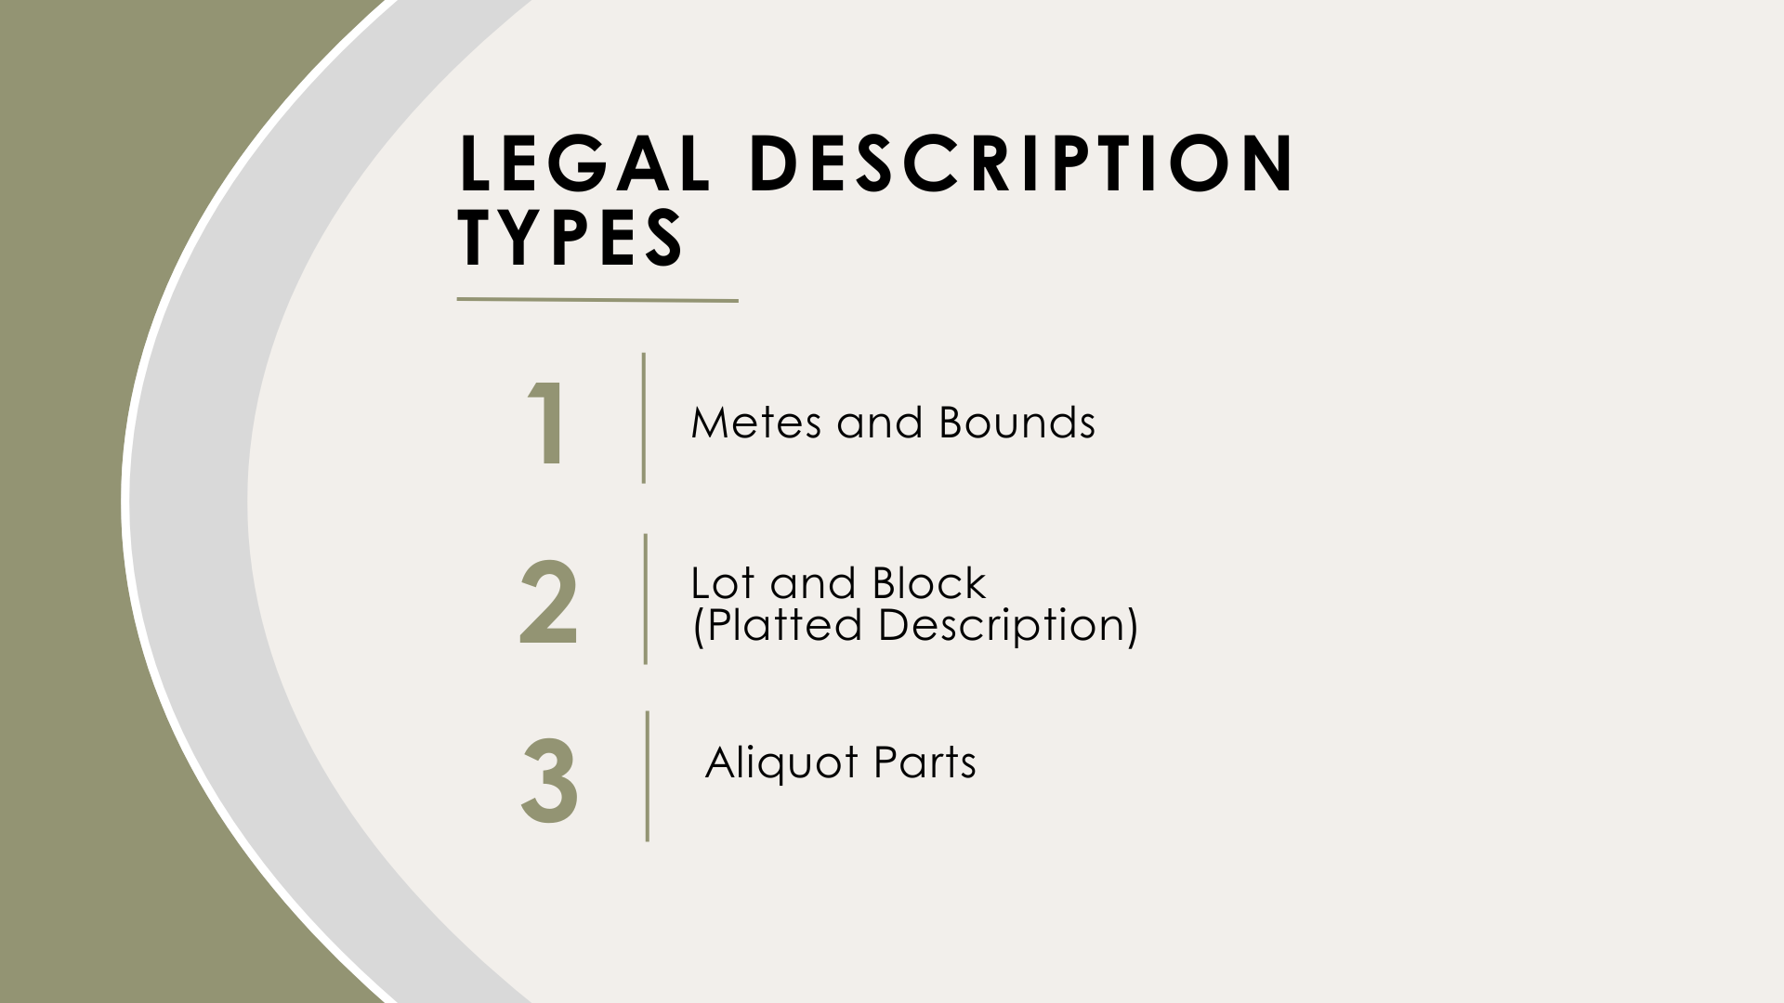
Notes:
(Talk through the legal description types.)
Aliquot Parts usually require a surveyor to rewrite the legal description.

Slide 16
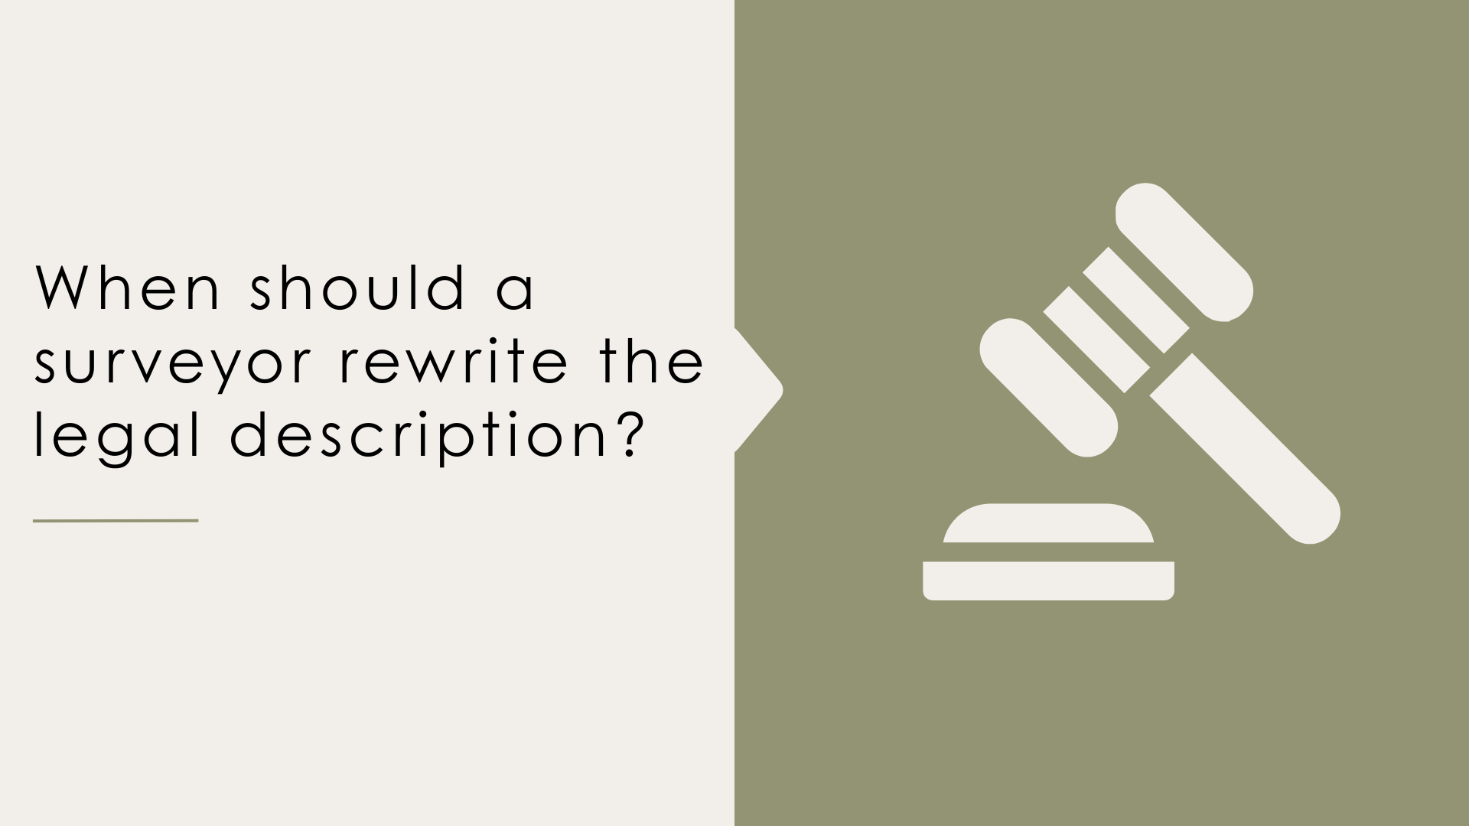
Notes:
And, you may be wondering, does every Alta Survey require a legal description rewrite?
No! The standards encourage us not to rewrite the description, unless there are significant issues.
I may rewrite the legal description when . . .

Slide 17
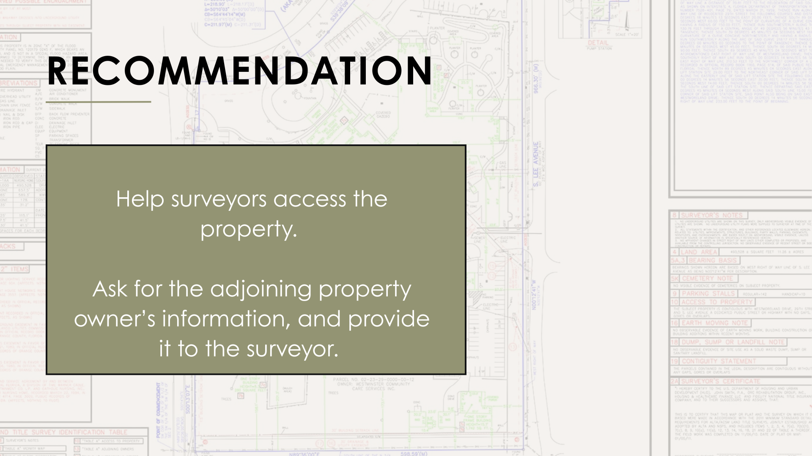

Slide 18
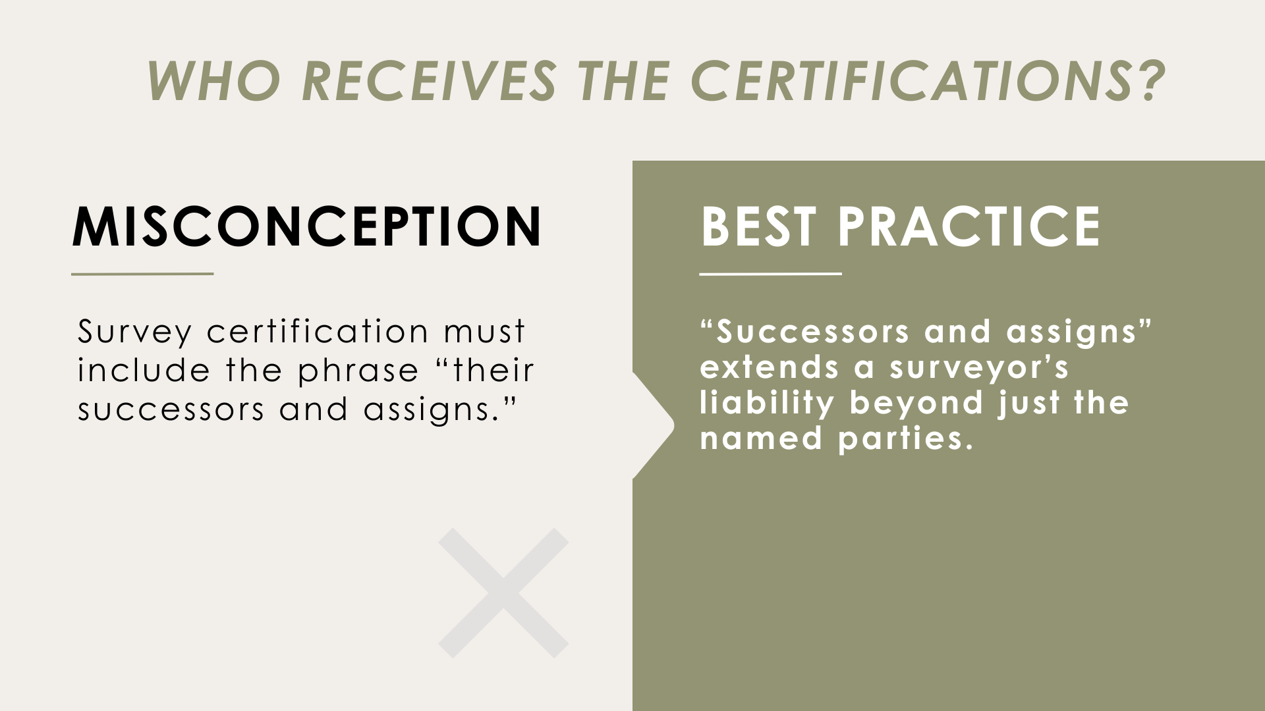

Slide 19
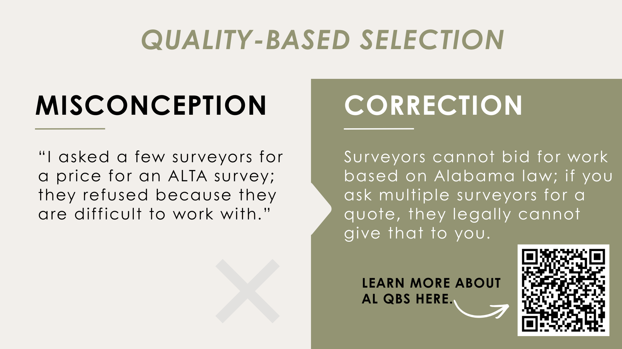

Slide 20
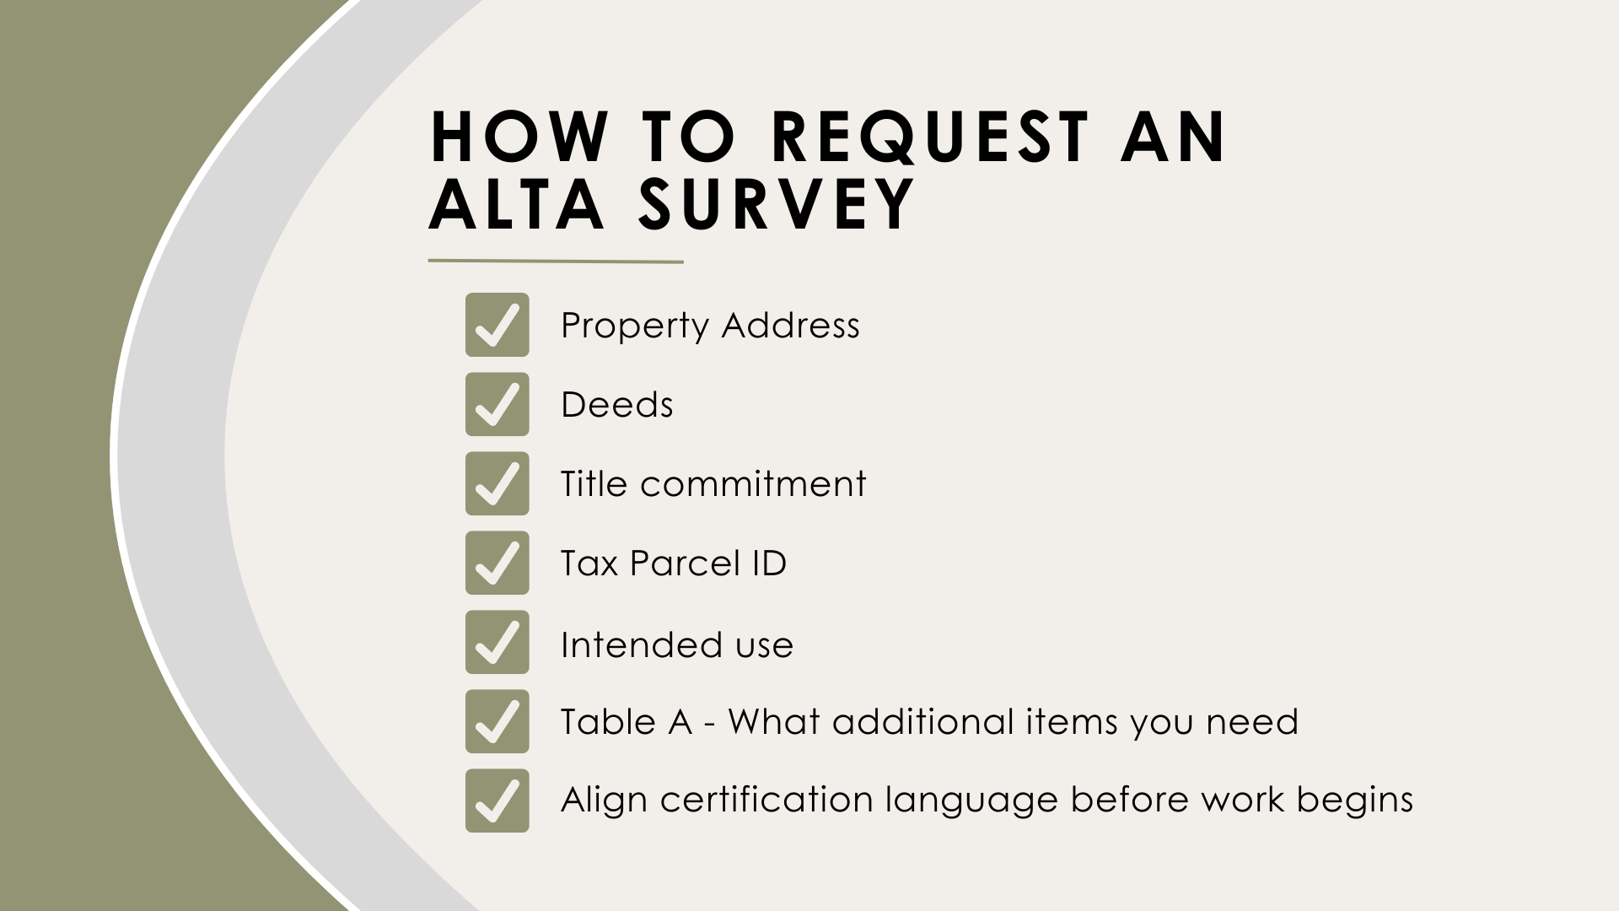

Slide 21
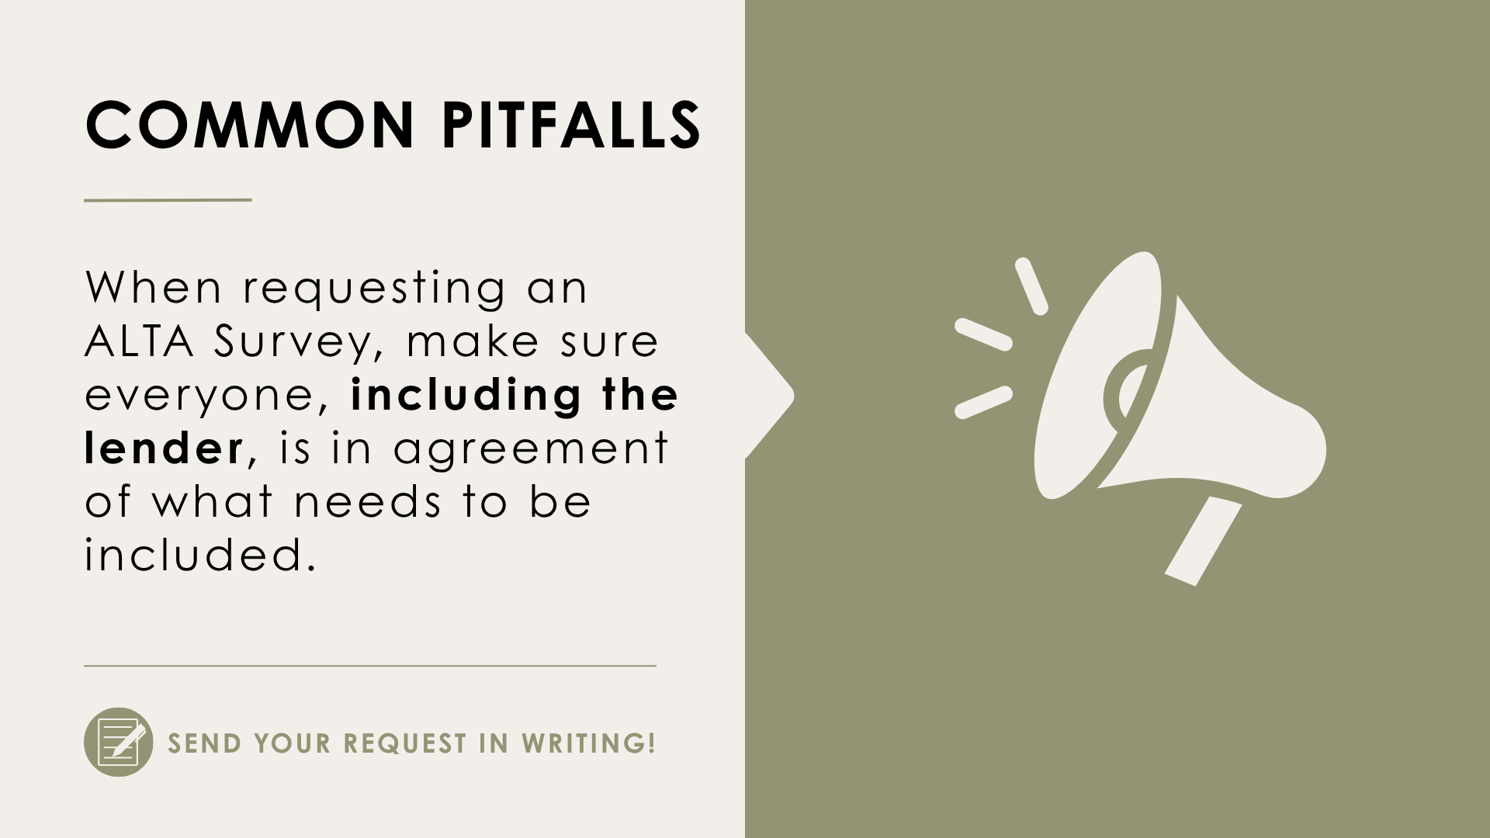

Slide 22
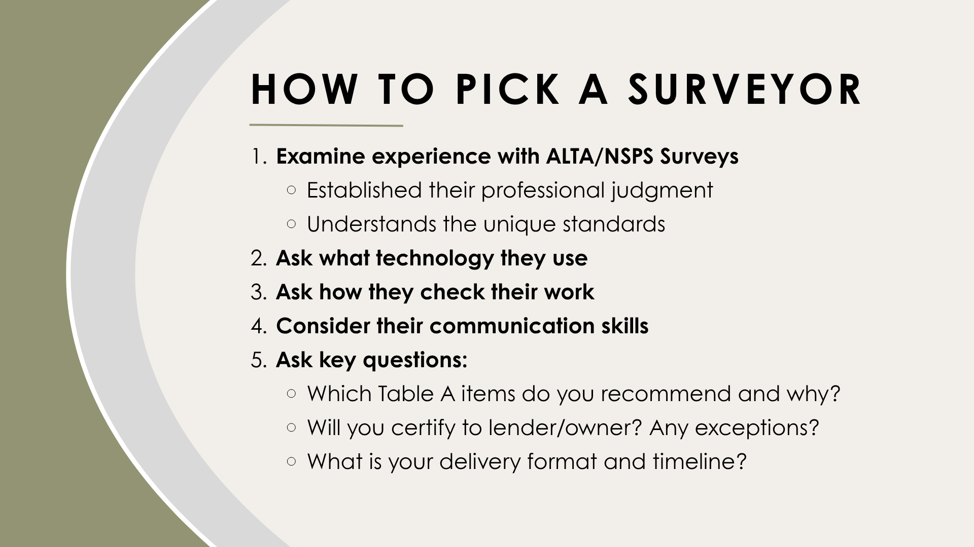

Slide 23
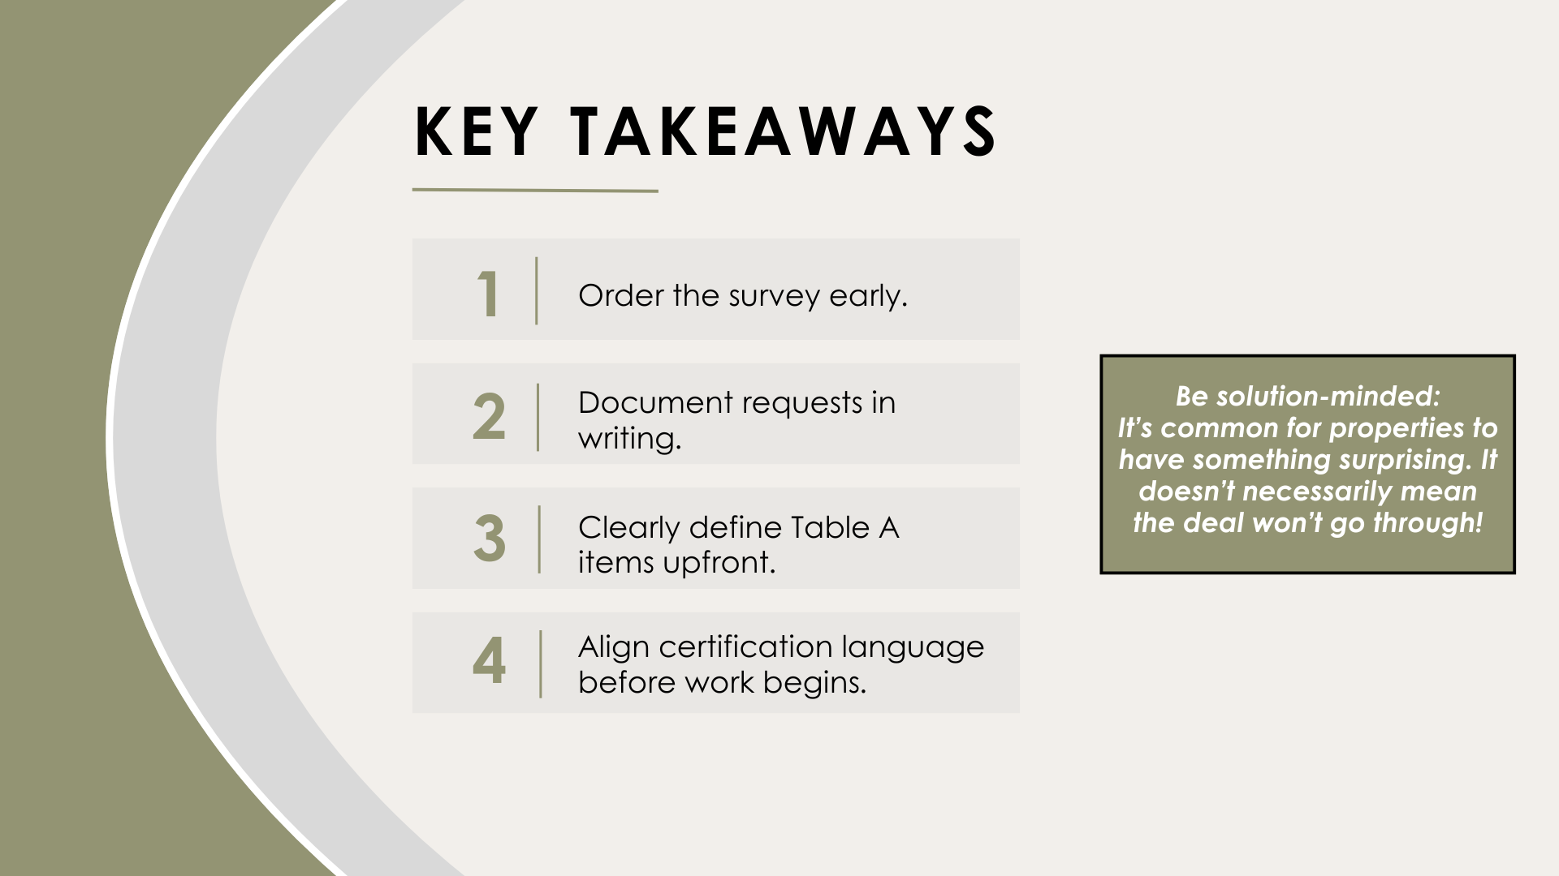

Slide 24


Slide 25
