Slide 1




Reading a Survey (into a Title Commitment)
Spencer Huey Hayes Ellett
Magic City Title Fidelity National Financial

Slide 2
ALTA/NSPS Land Title Survey
The purpose of an ALTA/NSPS Survey is to provide sufficient information for a title insurer to assess matters that may affect title but are not always apparent from the public records.
It is intended to identify boundary issues, access issues, easements, encroachments, and other matters that could impact ownership, use, financing, insurability or development of the property.

Slide 3
ALTA/NSPS Land Title Survey
What Table A Items do you want?
-Some Table A items are optionable, and some are not.
-When you are working directly with the client and surveyor, get the surveyor the title commitment and Table A items that you know you will want for coverage purposes (i.e., endorsements).
SAVES TIME FOR THE SURVEYOR NOT HAVING TO TAKE MORE TRIPS THAN NECESSARY!

Slide 4
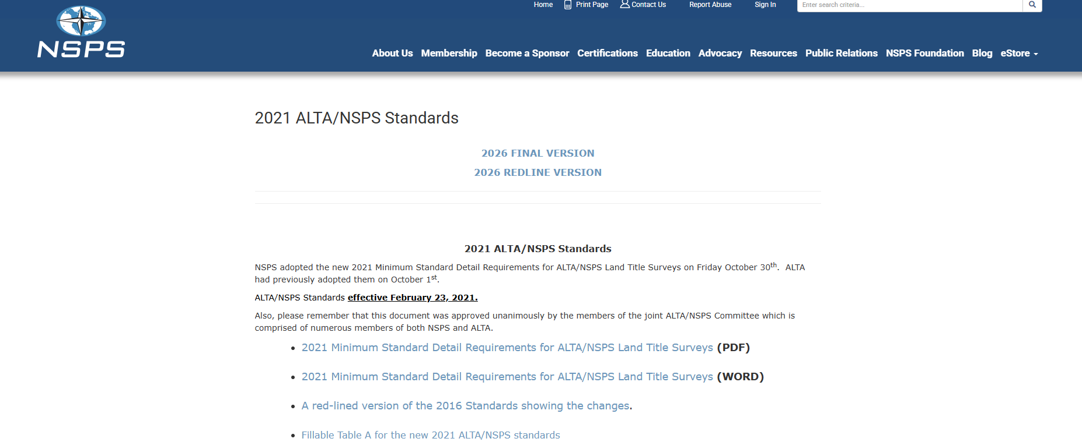

ALTA/NSPS Land Title Survey
Where do we go to get a copy of the ALTA/NSPS survey requirements:
https://nsps.us.com/page/2021ALTA

Slide 5

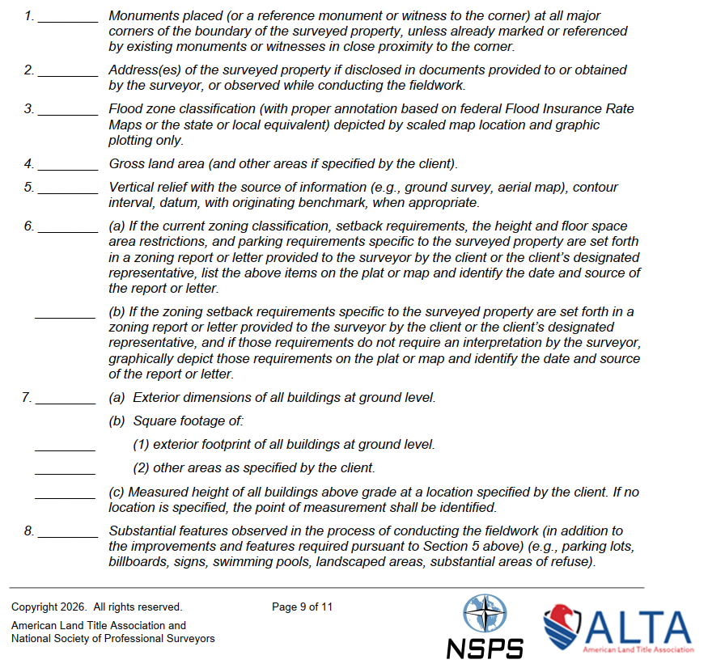


Should be a given, but included if markers are not already in the ground
Only needed if ALTA 22 Location is requested
Potentially needed for zoning endorsement (ALTA 3.1) or client information
ALTA 3
Potential to impact ALTA 3, ALTA 5 (PUD) and ALTA 9 endorsements (perhaps others)
Notes:
When we make the requirement for an ALTA survey, the surveyor will ask which Table A items do you want and the customer says, do what???
Monuments placed – the surveyor must set the corners. “PK Nail” – it’s a company that made nails. This is required in AL and MS.
Normally include address. To give the ATLA 22 endorsement, check with the local 911 office to verify the address.
We don’t need that included.
Good to include if we’re giving a zoning endorsement b/c the ALTA 3.1 certifies that the land area is within the area that it’s zoned for. Good to include.
Vertical relief – don’t need that information and doesn’t impact us for title purposes. The client may be building something on the property and the engineer/builder may need that info, but not us.
A and B – deals with the ALTA 3 series zoning endorsements. This was included in 2021 on the requirements because surveyors were interpreting zoning regulations incorrectly.
They’re helpful if we know which ones we’re issuing. The 3, 5 and 9 series are the ones we’re concerned about in getting this information confirmed via the survey.
We need this info – what if this is encroaching over an easement, i.e., utility line or boundary line? That would be an expensive repair replacing a pool where someone seeks enforce their easement rights.

Slide 6
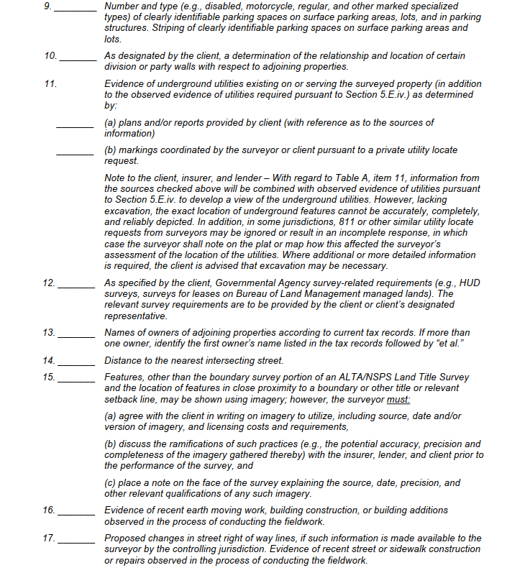
Zoning (ALTA 3)
As it relates to ALTA 4.1, ALTA 19, & ALTA 28 among others
ALTA 17.2 Utility Access endorsement
As it relates to MECHANIC’S LIEN coverage
Could be helpful as “eyes on the ground” if something is NOT clear of record
Notes:
9. We need to know how many parking spaces meets the requirement for the zoning classification to issue the endorsement.
10. Let’s check this whether or not we are aware there is a party wall, because we will need to know because if there is, we will need to account for it. Thankfully, they took out the plumb requirement in 2016.
11. This is necessary to give the ALTA 17.2 Utility Access endorsement
12. If this is a HUD loan, they will have a lengthy requirement for their purposes. Not necessary for ours.
13. If we need to track down neighbors for title purposes.
14. We’re not worried about distance, but only access.
15. IS DIFFERENT from what previously said in 2021. Digital photography.
16. We need to know this for mechanic’s lien coverage – surveyors should reflect this. May need to clarify what “recent” means with surveyor.

Slide 7
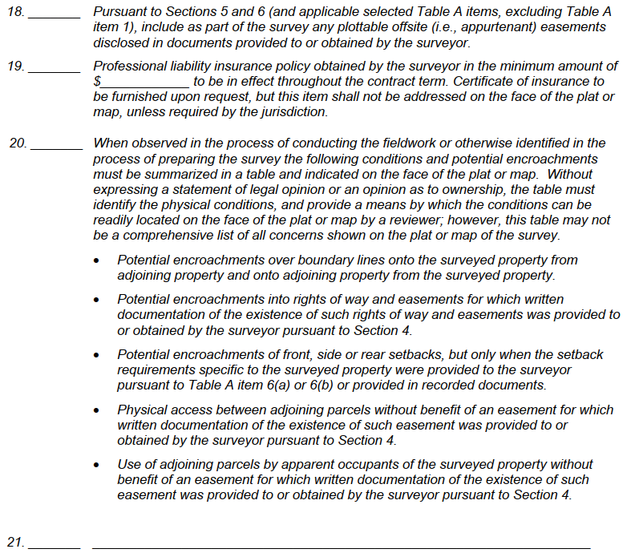
Could be needed if Land benefits from appurtenant easements (e.g., access or utilities)
OTHER – Can add matters if you like
Notes:
18. This is helpful to us know if there are any appurtenant easements – easement allowing a neighboring property owner to us our land or theirs.
19. It’s not a requirement for a licensed surveyor to carry professional liability insurance – however, it may not be a bad idea to ask if they have it or not.
20. This is newly added from 2021. Would love to have this information included because we will need to know this information for several endorsements – the ALTA 9 series and others.

Slide 8
How to perform a “Survey Read” into a Title Commitment
Once we receive the finalized ALTA/NSPS survey, we may remove the survey exception from the commitment and replace it with the specific matters that we see from reviewing the survey → this is the process of reading the survey into the commitment.

Slide 9
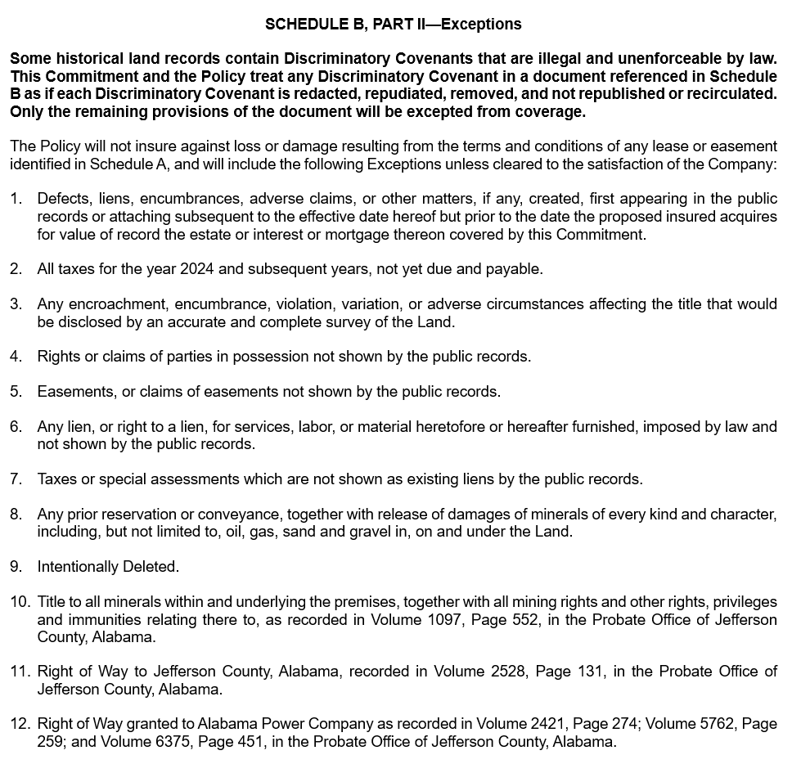
Standard
Exceptions
Specific
Exceptions
Notes:
-This was a commitment given to us – this is what we need to send the surveyor before they perform their work.

Slide 10
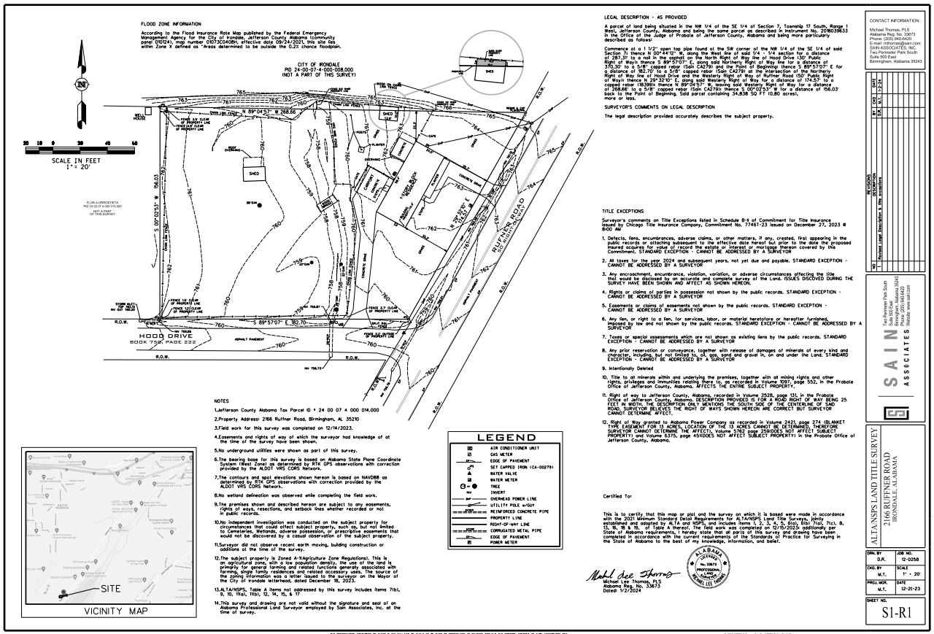
Notes:
-First thing I look for locate the compass – showing direction. Therefore, I can properly describe the boundaries – i.e., the northern boundary, southeastern boundary, etc.
-Next, I look at the legend. That should be the same or similar in every survey – just because it’s shown in the legend, does NOT mean it’s included in the survey.

Slide 11
Notes:
-Once I’ve reviewed the compass and legend, I work my way around the survey. I know the survey is blurry, but I’m going to zoom in on it.

Slide 12
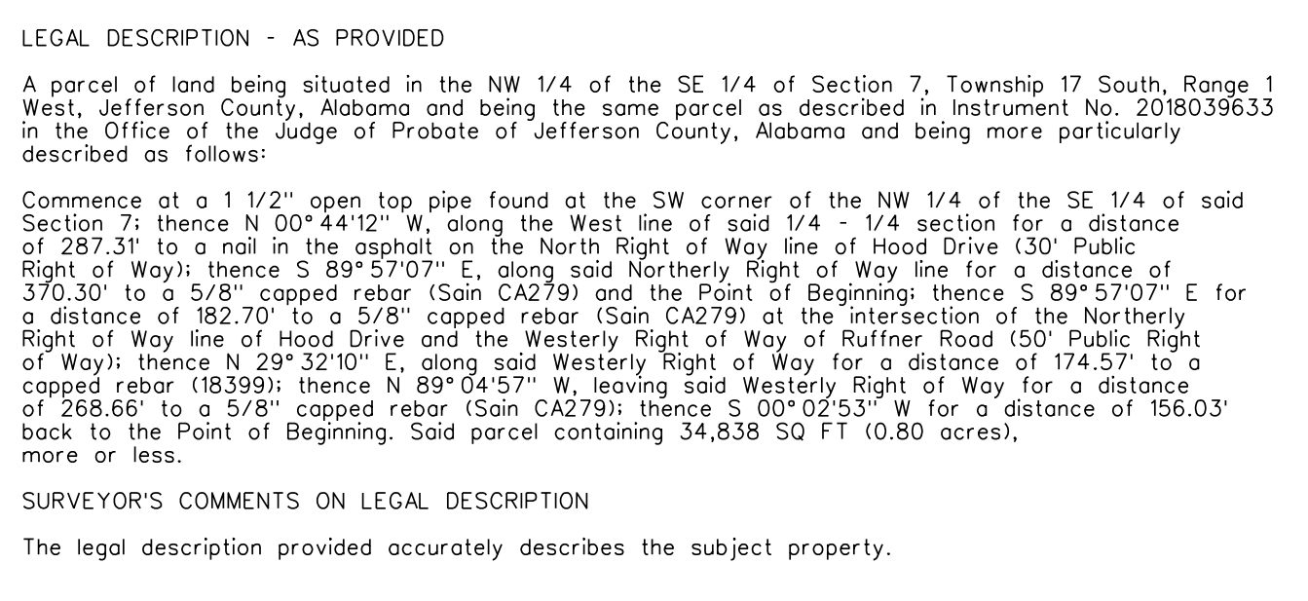
Legal Description
Notes:
-We’ve zoomed in.
-What if the legal is an old ‘meets and bounds’ description? We’ve all seen a legal where it references old neighboring property owners that are not around and don’t own those properties anymore, or where there are several ‘less and excepts’ in there – at that point we may need a new legal description. I’ve heard of surveyors including the reason they drafted a new legal in the survey.

Slide 13
Tie Vesting Deed Legal to Survey Legal
In Commitment →
  Insert Vesting Deed Legal into Exhibit A
    (and offer an ALTA 25 Same As Survey endorsement to tie it to the Survey Legal)
Notes:
-If the customer wants to confirm the current vesting legal (might be old or meets and bounds) and the new legal are one and the same, we could offer the ALTA 25 Same as Survey endorsement. This confirms the survey done (possibly previously) is the same as the legal description previously described.

Slide 14
Tie Vesting Deed Legal to Survey Legal
In Commitment →
  1) Insert Vesting Deed Legal into Exhibit A
  2) Insert the following:
    “More particularly described as set forth on the survey prepared by [Insert Surveyor Name] with [Insert Survey Company] dated [Insert Survey Date], last revised [Insert latest revision date (if any)], and designated as Job No. [Insert Job or Drawing No.], as follows:”
  3) Insert Survey Legal into Exhibit A
Notes:
However, if they don’t want to go the ALTA 25 route, then we offer to enter all three of the above.
-This will help in clarifying and tying it in together, and be able to use the new legal going forward into the future.

Slide 16
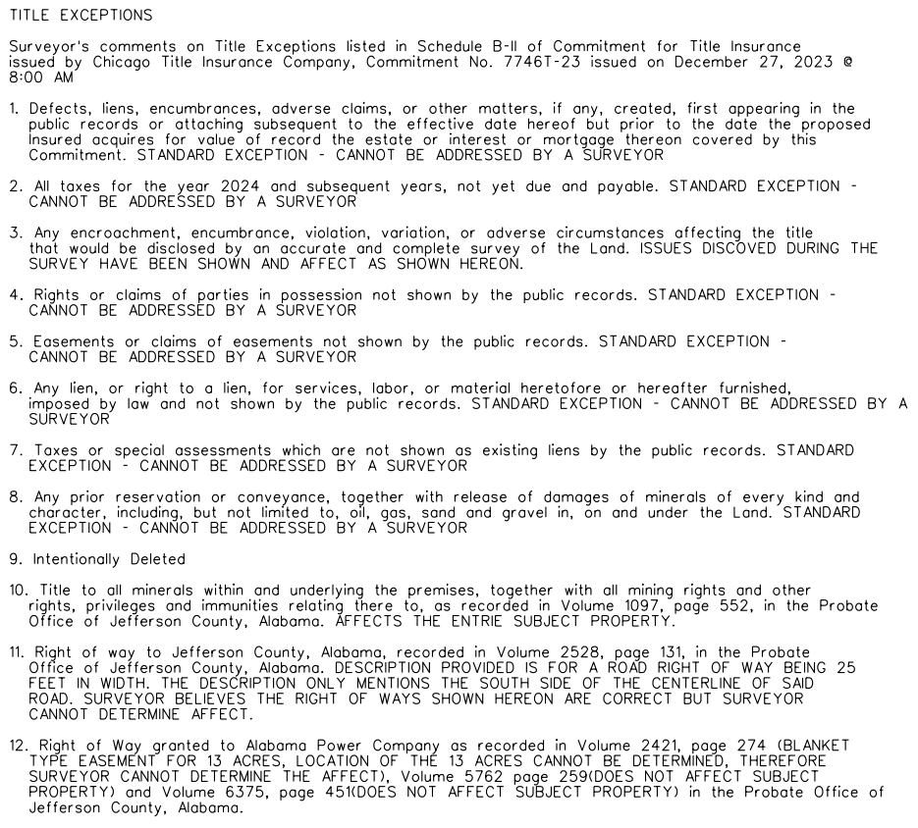
Standard
Exceptions
Specific
Exceptions
Notes:
-Here the surveyor is making notes – standard exceptions and our specific exceptions. Does it affect the property?
-Ask Michael, where these are shown on the survey? If they were shown on our survey, we could reflect that in our title commitment.

Slide 17
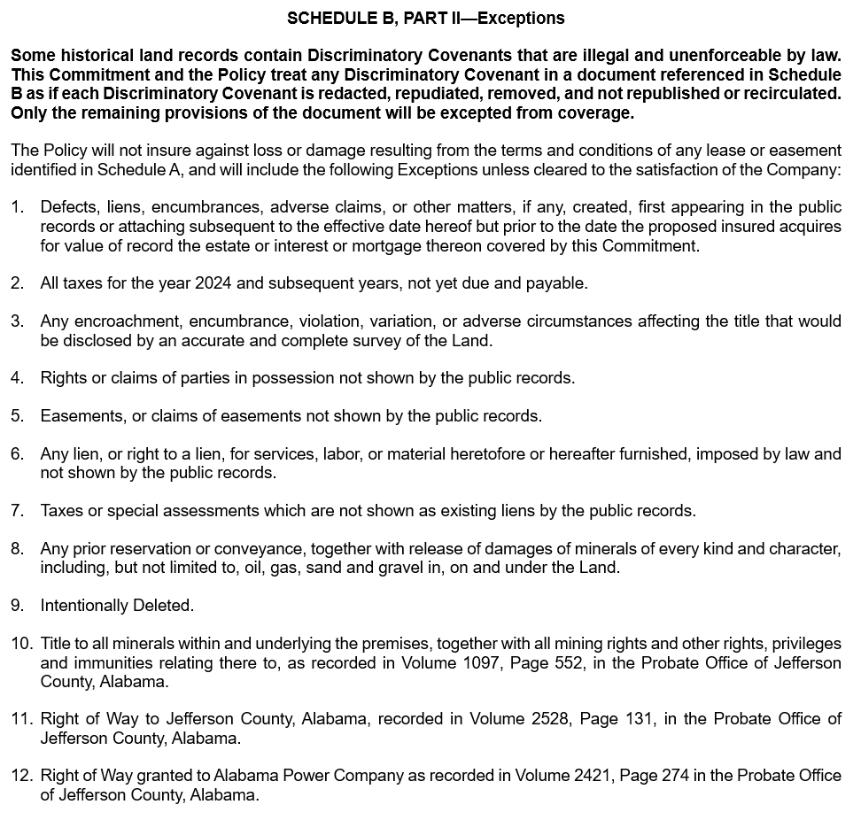
Schedule B-II
Revised Commitment
Notes:
-What we can do now is, since we don’t need two of the same exceptions, can “Intentionally Delete” that one, right Doug?
-We can add in all the easements shown in the survey under #11. Making it more specific for the customer.
-THIS IS NOT THE SURVEY READ YET.
-#12 is also shown and we will add the “shown on” language since it’s also shown on the survey.

Slide 18
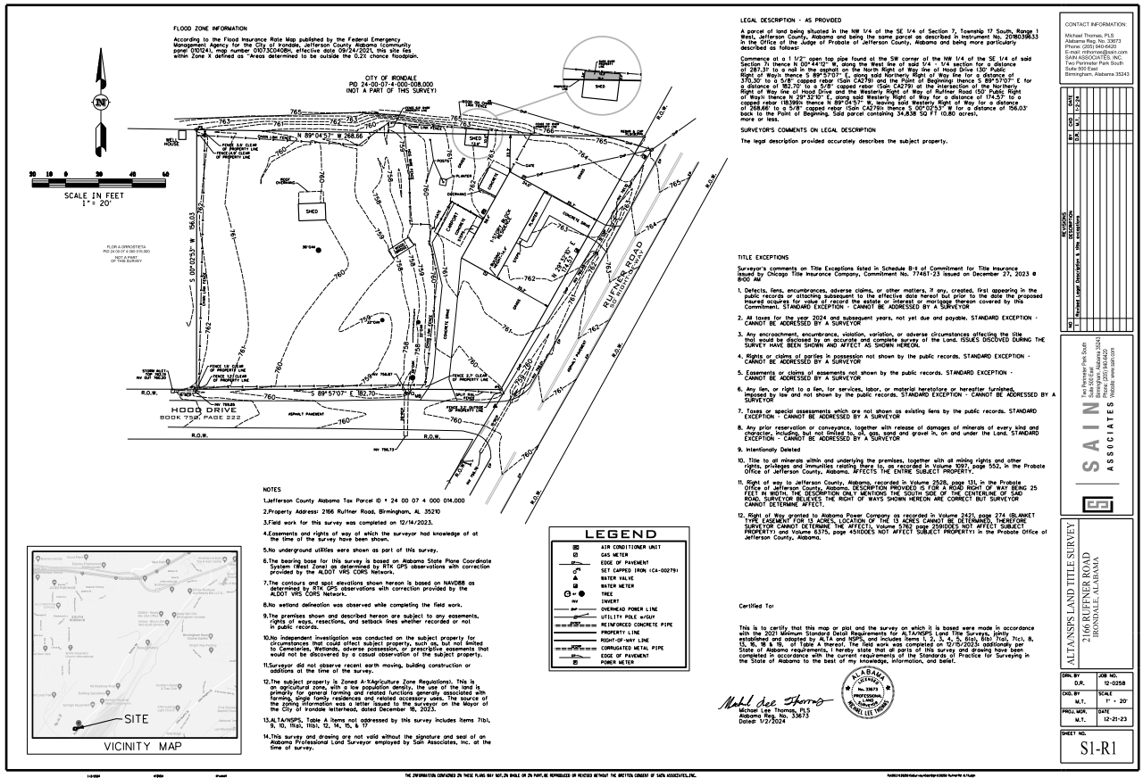

Slide 19
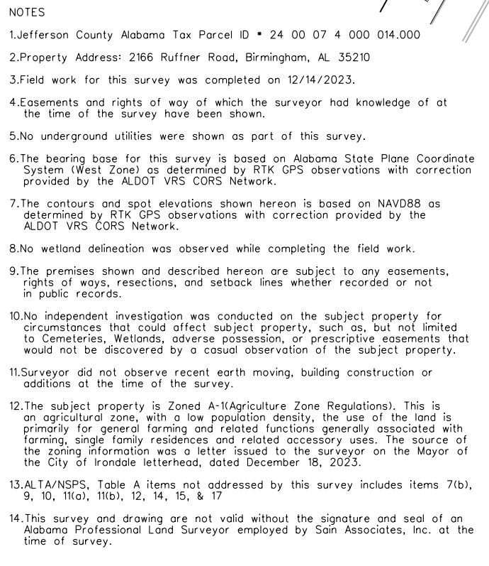
1-May help with ALTA 18 – Tax Parcel endorsement
2-May help with ALTA 22 – Location endorsement
11-Helps if we are giving mechanic’s lien coverage
12-May help with the Zoning endorsement – ALTA 3 series

Slide 20


Slide 21
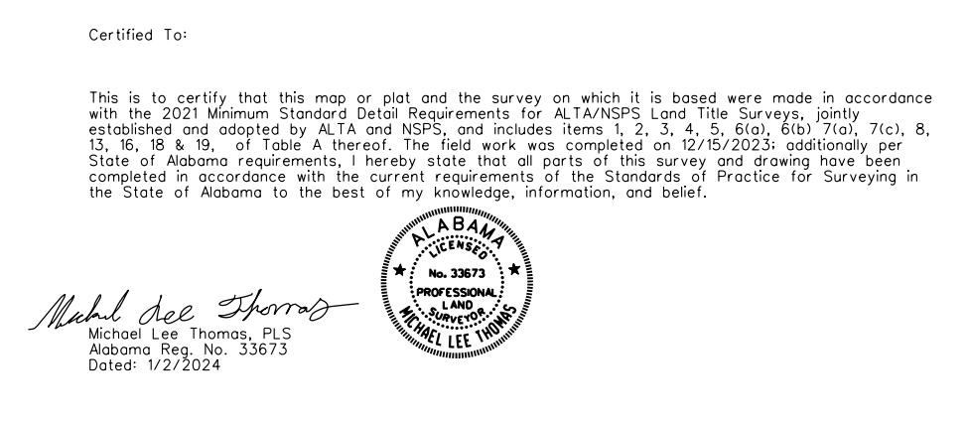


Slide 22
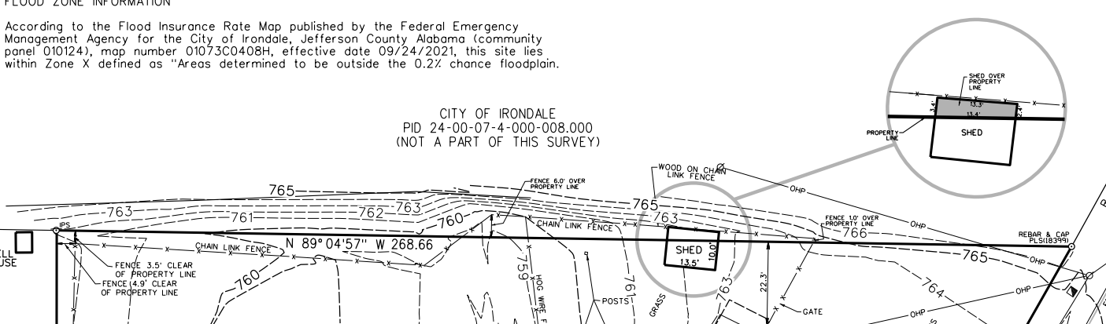









Northern Boundary

Slide 23
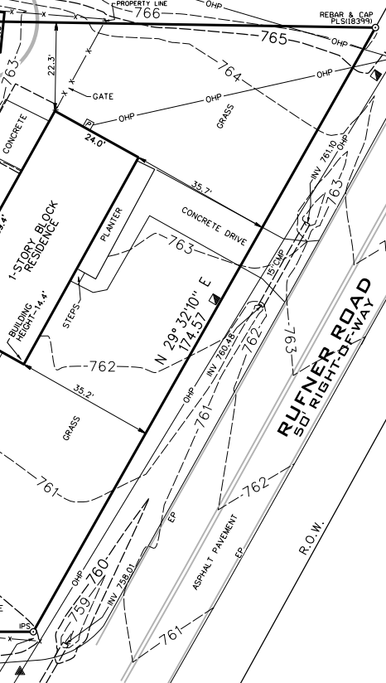
Eastern Boundary

Slide 24
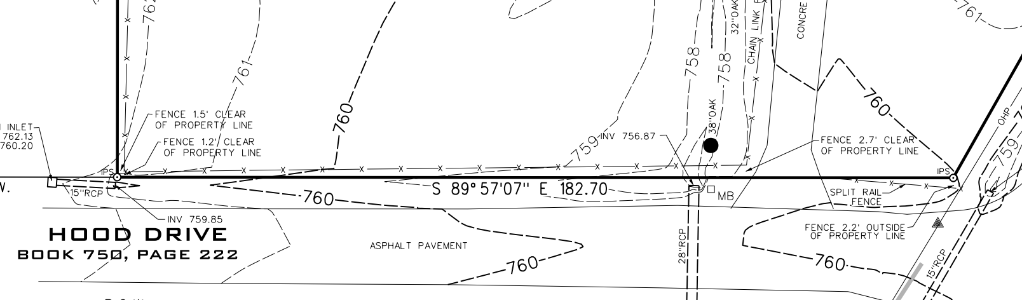



Southern Boundary

Slide 25
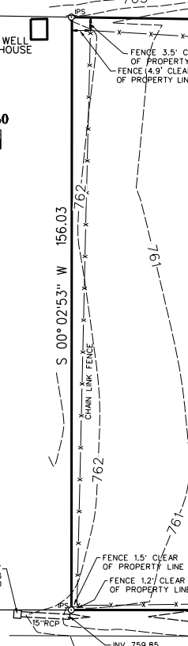
Western Boundary

Slide 26
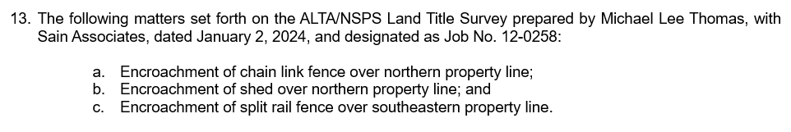
Schedule B-II
Revised Commitment
SURVEY READ
Notes:
Now we go back to the title commitment – since they have the ALTA/NSPS survey, we can remove the survey exception include the encroachments (intentionally deleted) and add #13 and copy and paste what the surveyor included for the encroaching.

Slide 27
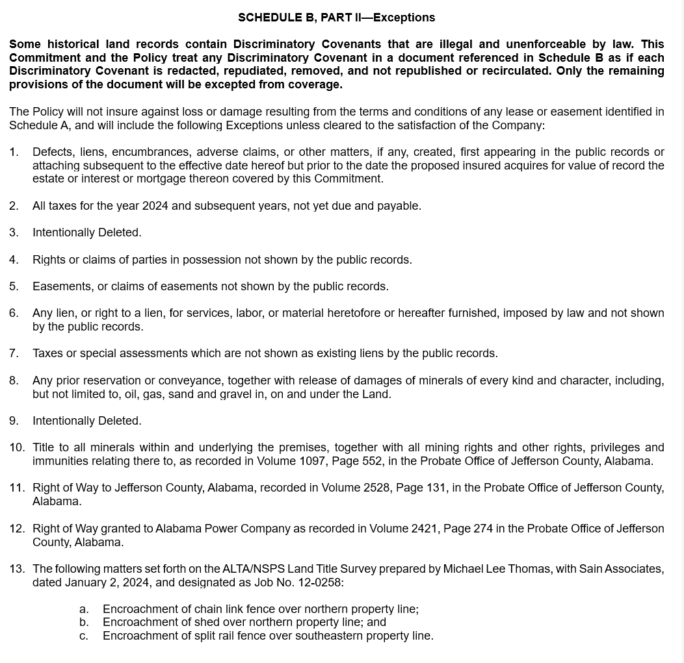
Schedule B-II
FINAL Commitment
Notes:
This is what your final commitment ends up looking like after you have performed your survey read. We removed the survey exception on the earlier page. We removed #8 because it was repetitive of #11. Added #13 with everything included from our survey read – we removed the survey exception but also added back into specific matters shown on the ALTA survey.

Slide 28

Thank you!

